Slide 1

Sulfur hexafluoride (SF₆) in the atmosphere today
Steve Montzka, NOAA
Sources of information used in this analysis:
- 2022 Scientific Assessment Panel Report (WMO/UNEP)
- The peer-reviewed scientific literature
(e.g., Simmonds et al., 2020; Hu et al., 2023; Vojta et al., 2024; Western et al., 2025)
- Data from NOAA and AGAGE (publicly available)
Focus of today’s presentation:
- Background information on sources & removals; climate metrics
- Global-scale atmospheric abundance and implied emissions
- contributions to climate warming
- Regional-scale emission contributions
Thanks to colleagues at NOAA and AGAGE, particularly L. Western & X. Lan. September, 2025

Slide 2
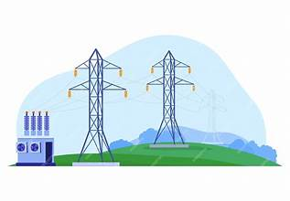
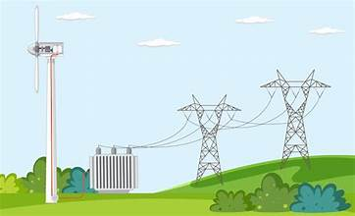
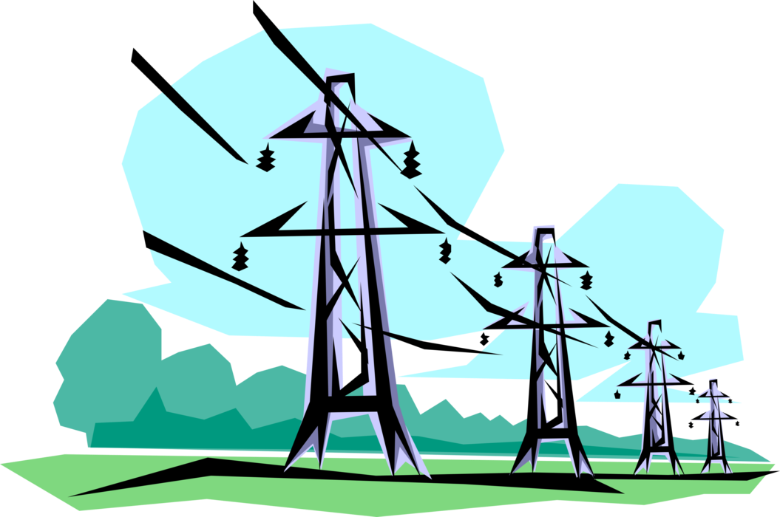
Sulfur hexafluoride (SF₆):
* one of the 6 “basket of gases” named in the Kyoto Protocol to the UNFCCC
Sources:
* Industrial production for use in:
- high-voltage electrical equipment as a dielectric and insulator in gas-insulated switchgear, gas circuit breakers, high-voltage lines, and transformers. (80%)
  magnesium industry (4%),
  electronics industry (8%),
  misc. (8%)
* natural sources are insignificant

Slide 3
Sulfur hexafluoride (SF₆):
Removals:
UV photolysis and reactions with electrons in upper atmosphere (mesosphere),
- lifetime (850-1280 years*)
Atmospheric decline in the absence of emission
In the absence of emissions, the atmospheric concentration of SF₆ would decline at 0.08 to 0.12% yr⁻¹.
Given that the climate influence of a long-lived gas is proportional to its atmospheric concentration, a pulse of SF₆ or other long-lived gas will affect Earth’s radiative balance for hundreds of years.
The GWP₁₀₀ of SF₆ is 24700.
The GWP₁₀₀ metric does not include climate influences >100 years in future
lifetime
* SAP 2022 Assessment (Burkholder and Hodnebrog, 2022)

Slide 4
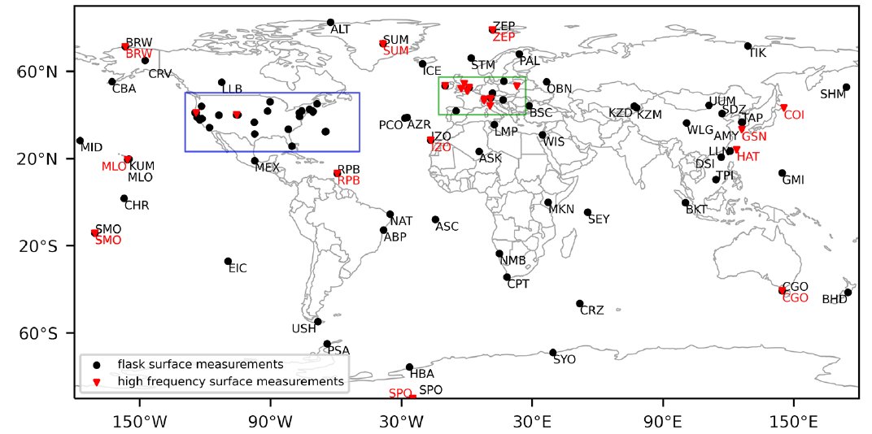
Atmospheric surface measurements of SF₆ (2005 - 2021)
Data are predominantly from NOAA and AGAGE
Latitude
Black = flask
Red = on-site
Longitude
From Vojta et al. (2024)

Slide 5
Global atmospheric surface abundance of SF₆
SF₆ is measured consistently by both NOAA and AGAGE
Concentrations were much lower in the late 1970s compared to today
The rate of increase was about 3.7% yr⁻¹ over the past decade (0.37 ppt yr⁻¹) and is accelerating.
Parts per trillion (ppt)
year
Source: NOAA web data and Simmonds et al. (2020)
* pre-1997 AGAGE results are based on measurements at one site (40 °S) using an air archive
Notes:
Doubling time is ~20 years

Slide 6
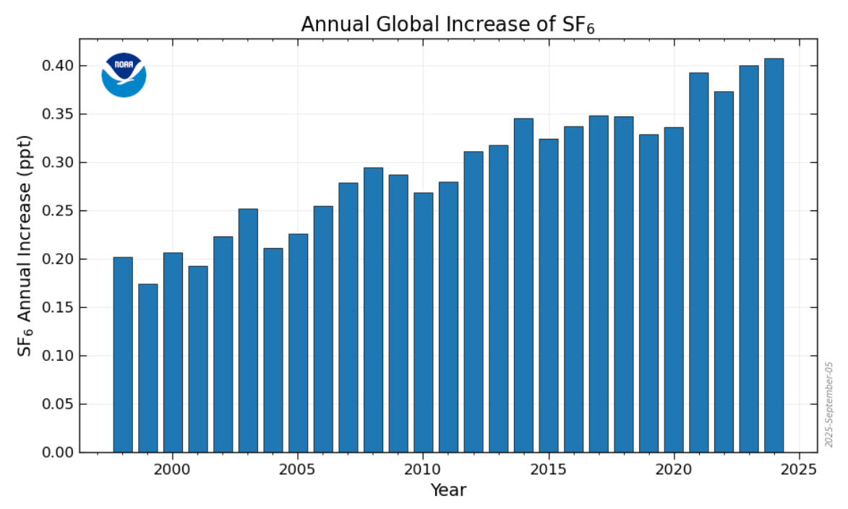

Slide 7
SF₆ global emission
Global emissions have steadily increased since 2000
Atmosphere-
derived
NOAA
AGAGE
SF₆ global emission (Gg yr⁻¹)
year
From Simmonds et al. (2020)
Note 1 Gg = 1 kt

Slide 8
SF₆ global emission
Global emissions have steadily increased since 2000
Atmosphere-derived emissions are substantially larger than UNFCCC augmented reporting totals (gaps filled for some years for non-Annex1 countries)
Atmosphere-
derived
NOAA
AGAGE
UNFCCC total
SF₆ global emission (Gg yr⁻¹)
Substantial declines are reported from Annex1 countries; increases from non-Annex1 countries
UNFCCC non-Annex1
UNFCCC Annex1
year
From Simmonds et al. (2020)

Slide 9
SF₆ global emission
Global emissions have steadily increased since 2000
Atmosphere-derived emissions are substantially larger than UNFCCC augmented reporting totals (gaps filled for some years for non-Annex1 countries)
Atmosphere-
derived
NOAA
AGAGE
UNFCCC total
SF₆ global emission (Gg yr⁻¹)
Substantial declines are reported from Annex1 countries; increases from non-Annex1 countries
GAP
UNFCCC non-Annex1
UNFCCC Annex1
A large GAP exists between atmosphere-derived and UNFCCC total emissions
year
From Simmonds et al. (2020)

Slide 10
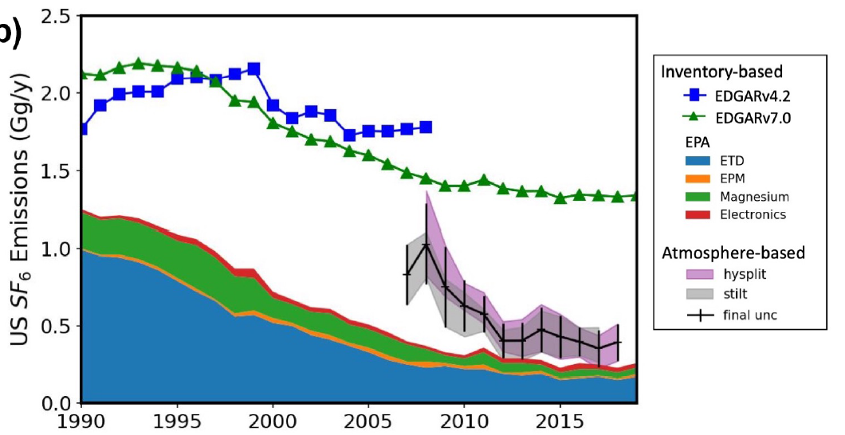
Emissions of SF₆ from the U.S.
Atmospheric observations confirm the substantial decline in U.S. inventory emissions over time
Underreporting is apparent, particularly in earlier years
U.S. accounted for 0.39 Gg SF₆, or ~4% of global total emissions, in 2018.
Atmosphere-
derived
U.S. EPA
Inventory
(submitted to
UNFCCC)
U.S. Emission (Gg yr⁻¹)
Electric power transmission and distribution
Electrical equipment manufacturing
Magnesium production
Electronics industry
NOAA analysis in Hu et al. (2023)

Slide 11
Other regional emissions derived from atmospheric observations
Percentages are contributions to the global total in 2021
Global total –
Atmosphere-
based
inversion
SF₆ emissions(Gg yr⁻¹)
China, global network (53%)
China, Gosan measurements only
China to UNFCCC
U.S.A., global network (5%)
E.U., global network (3%)
Global network poorly constrains emissions from Africa, India, S. America
From Simmonds et al. (2020) and Vojta et al. (2024)

Slide 12
Comparing the global climate impacts of SF₆ to HFC-23 and other gases
Emissions
(MMt CO₂ -eq yr⁻¹)
Forcing (mW m⁻²)
Chemical RF (mW m⁻²) Emiss. (CO₂-eq, MMT yr⁻¹)
SF₆ 5.8 250 +/- 15
HFC-23 6.5 210 +/- 10
CFC-11 70 300 +/- 60
CFC-12 195 308 +/- 260
HCFC-22 52 654 +/- 100
HFC-134a 22 360 +/- 40
CFCs 286 700 +/- 400
HCFCs 61 700 +/- 100
HFCs 46 1220 +/- 50
GWP_{SF6} = 24700 vs 14700
Lifetime_{SF6} = 850 - 1280 yr vs 228 yr
R.E._{SF6} = 0.574 vs 0.193 Wm⁻² ppb⁻¹
Values in ~2020-2023

Slide 13
Summary, p. 1 of 2
SF₆ is an extremely long-lived, human-produced, potent greenhouse gas:
* the impacts of emissions today will be with us for thousands of years
(40% of today’s emission will be in the atmosphere in the year 3000).
* stabilization of atmospheric concentrations is only achievable with near-zero emissions.
The current contribution of SF₆ to global radiative heating is:
* comparable to HFC-23
* 15% of all HFCs;
* 1.8% of all Montreal-Protocol controlled gases.
A substantial gap exists in our understanding of global emissions
* Global SF₆ emissions are substantially larger than reporting to UNFCCC
* Global SF₆ emissions in 2023 were 10.2 +/- 0.6 kt yr⁻¹ (250 MMt CO₂-eq yr⁻¹)
and recently are comparable to those of HFC-23, CFC-11, and HFC-134a
* China accounts for about half of recent global emissions
emissions from all continents are not well characterized

Slide 14
Summary, p. 2 of 2
SF₆ emissions continue to increase even in the presence of UNFCCC controls
Mitigation efforts can be effective
* substantial declines are reported for the sum of Annex1 countries
* an emission decline is confirmed by atmospheric data in the U.S.
Without further mitigation efforts large increases in SF₆ emissions seem likely
* as society moves away from fossil fuels and electrifies power grids.

