Slide 1
EU regulatory measures to phase out SF₆ in switchgear
DG CLIMA, European Commission
Accra Helsinki Group, SF6 side event, 3 November 2025

Slide 2
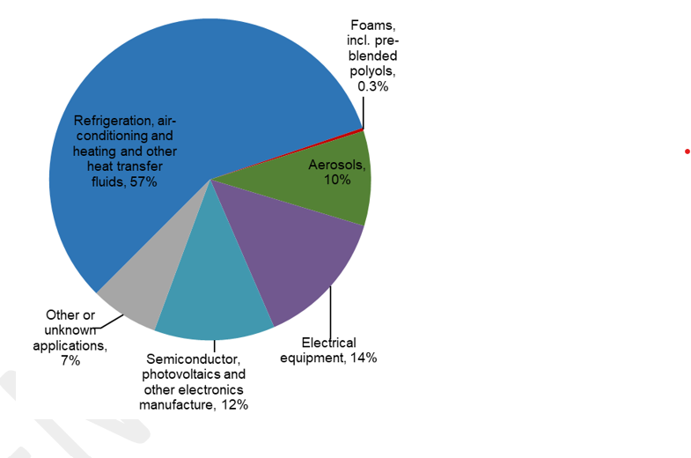
Fluorinated GHGs („F-gases“) supplied to the EU market (% CO2e)
Greenhouse Gas | GWP (AR 4 or 6*, 100 years)
CO₂ | 1
CH4 | 25
N2O | 298
HFC 134a | 1 430
HFC 404A | 3 922
HFC 410A | 2 088
HFC 125 | 3 500
HFC 23 | 14 800
PFCs | ca. 7 400 – 12 400
SF₆ | 24 300*
NF₃ | 17 400*
EU supply to the market of F-gases
Source: European Environmental Agency 2024 -
Report on fluorinated greenhouse gases

Slide 3
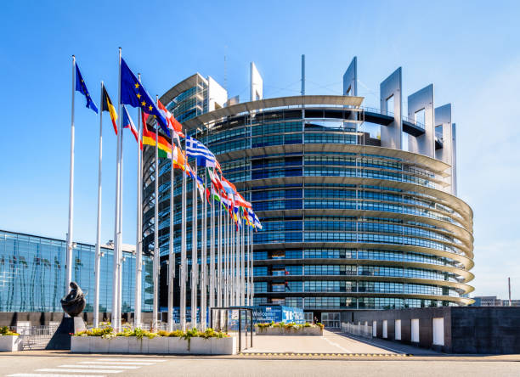
New Rules for EU policies on F-gases
New (3rd) EU F-gas Regulation 11 April 2024
→ Rules immediately apply in all 27 EU Member States
Significantly higher ambition in line with the Green Deal
  Phase-out of HFCs by 2050, Reduction to 95% by 2030
  Many new restrictions in products & equipment, including on other F-gses and SF6

Slide 4
Evaluation of 2014 F-gas Regulation
→
Not a lot of progress made on reducing SF₆ with previous rules
A lot of ageing switchgear from the 70s and 80s is due for replacement
New energy policies and renewables require grid develoment and upgrading with new switchgear deployed
→ Under BAU, we would risk putting in place a lot of SF₆ equipment with lifetimes of 50 years and more, leading to emissions long after 2050

Slide 5
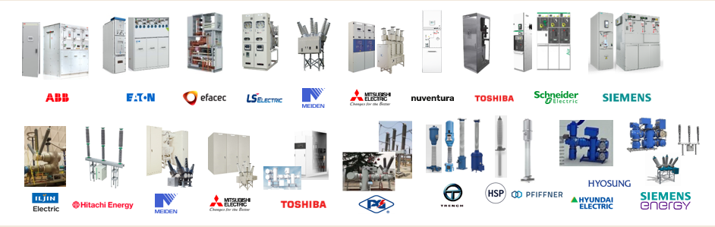
Recent technological progress
Examples for companies with Fgas-free alternatives in electrical switchgear
F-gas free alternatives include technical air (N₂ and O₂), ambient air, CO₂ and solid/liquid insulation for insulation; and vacuum as switching medium. All these have very low to zero GWP

Slide 6
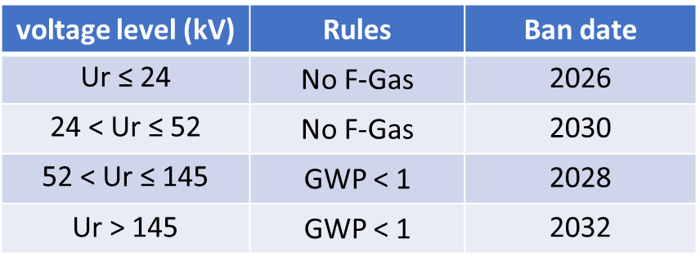
Reducing the use of SF₆ in new switchgear
  Clear policy message: Prohibition to put into operation new switchgear with F-gases
  .. unless not feasible for site-specific and use conditions (proved by tendering process)
  → then an F-gas with a GWP up to 1000 may be used (e.g. fluoronitrile mixtures with a GWP of ca 600)
  ..unless also not feasible (proven by tender) → any gas including SF6 may be used
  „CASCADED RESTRICTIONS“ to address availability issues
Starting point
depends on
voltage level
More time for high-voltage

Slide 7
Reducing the use of SF₆ in switchgear
  Even though electrical switchgear comprises many different and specialized applications at different voltage levels
    The rules/derogations enable a technology push for the whole sector, to allow the swift introduction of alternatives also in fringe applications
    The most environmentally benign alternative to be used wherever this is possible…
    …and wherever this is not yet possible, there is an incentive to develop such solutions
For existing, installed switchgear
  From 2035 virgin SF₆ cannot be used for servicing and maintenance
→ incentive to reclaim SF₆ and reduce losses (servicing/end-of-life), reduction of emissions also from old switchgear
A review of the rules will be carried out by 2030

Slide 8
Impact beyond EU
Strong policy push in EU
Availability of SF6-free equipment at large scale
Cost of equipment will go down
Accessibility of alternative equipment in other markets
Everyone will benefit. A huge ramp-up already going on in EU.
Hope that F-Gas Regulation could be a trigger for multiplication of action.
We are happy to share our expertise on the policy side with others. This may be a way of increasingly including action on SF₆ in their NDCs.

Slide 9
In a nutshell
There is ground for optimism in this sector:
  We have many alternatives for SF6 already
  We have innovative industry that can lead the transition.
In light of this, inaction would be inexcusable as switchgear equipment would otherwise increasingly add to our global emissions.
Policy can drive this transition.
There seems to be a growing interest by countries that may not have been aware of this sector.
There are clear opportunities available to developing and middle-income countries, and CTCN could help.

Slide 10

Thank you arno.kaschl@ec.europa.eu https://climate.ec.europa.eu/eu-action/fluorinated-greenhouse-gases/eu-legislation-control-f-gases_en
© European Union 2020
Unless otherwise noted the reuse of this presentation is authorised under the CC BY 4.0 license. For any use or reproduction of elements that are not owned by the EU, permission may need to be sought directly from the respective right holders.
Notes:
Update/add/delete parts of the copy right notice where appropriate.
More information: https://myintracomm.ec.europa.eu/corp/intellectual-property/Documents/2019_Reuse-guidelines%28CC-BY%29.pdf

