Slide 1
Breaking News & Sensational Findings
Reported to the Accra/Helsinki Group at the 37th MOP Montreal Protocol
by
Stephen O. Andersen, PhD
Director of Research, Institute for Governance & Sustainable Development

Slide 2
Breaking News: 2nd Nobel Prize for Chemistry Drives Montreal Protocol Success!
1995
Paul J. Crutzen, Mario J. Molina, and F. Sherwood Rowland earn Nobel Prize in Chemistry for warning that humans cause stratospheric ozone depletion and climate change!
2025
Susumu Kitagawa, Richard Robson, and Omar M. Yaghi earn Nobel Prize in Chemistry for inventing porous materials called metal–organic frameworks (MOFs) that can capture carbon dioxide and other pollutants in the atmosphere and can revolutionize refrigerant recycling!

Slide 3

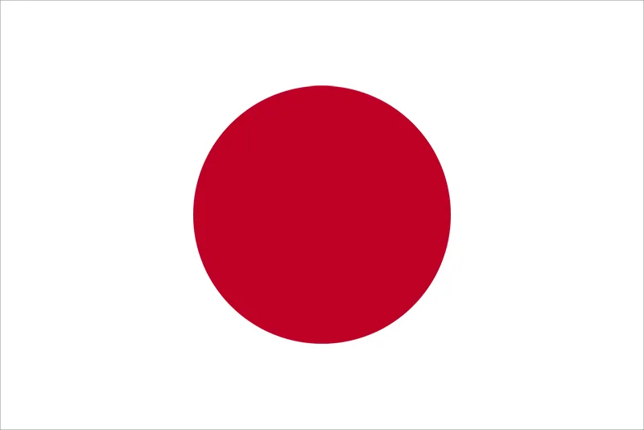




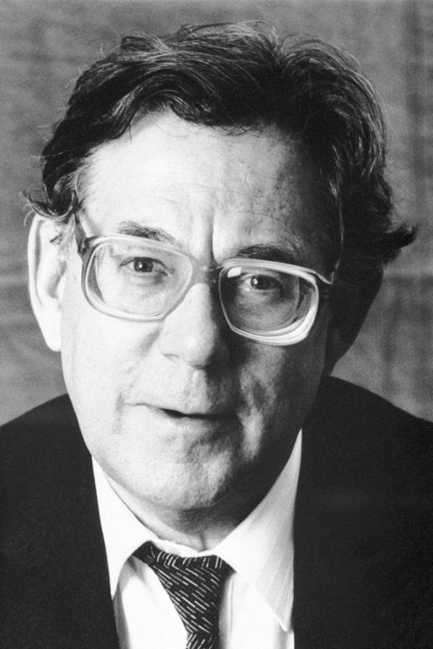
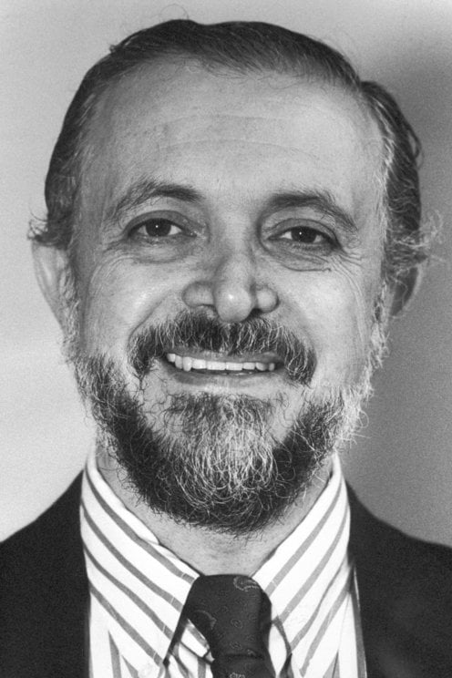
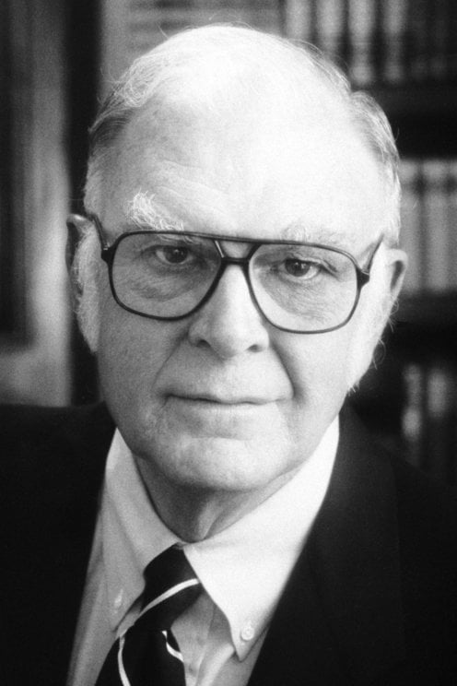
6 Scientists! 5 Countries! 4 Continents! 2 Nobel Prizes! 1 Earth and Atmosphere!

Slide 4
Sensational 2025 Findings: National Oceanographic and Atmospheric Administration (NOAA)
Montreal Protocol reduced toxic perchlorate groundwater pollution!
“…a reminder that the stratosphere is not fully understood.”
The growing list of Montreal Protocol co-benefits:
Agriculture and natural ecosystems
Aquatic and terrestrial carbon sinks
Built environment
Climate
Groundwater
Human health

Slide 5
Sensational 2025 Findings: Institute for Governance & Sustainable Development, Planetary Guardians, Potsdam Institute for Climate Impact Research, and PlusWonder
Protecting the Stratospheric Ozone Planetary Boundary also protected climate, land, ocean, and biosphere!
How the Montreal Protocol Put the Stratospheric Ozone Layer on the Path to Recovery and Delayed Climate Tipping Points That Would Have Forced Earth Further Beyond Planetary Boundaries
Stephen O. Andersen, Johan Rockström, Jean Oelwang, Guus J. M. Velders, Suely Carvalho, Marco González, and Durwood Zaelke
Seven out of nine Planetary Boundaries have been breached!
Planetary Health Check 2025
Potsdam Institute for Climate Impact Research and Planetary Guardians

Slide 6
Sensational 2025 Findings
Fast HFC Phasedown Under the Kigali Amendment is Less Expensive than if Slow
Less costly for:
Non-Article 5 donors to the MLF (less to pay for)
Buyers of new cooling equipment (lower ownership costs)
Neighbourhoods and cities (less pollution from fossil fuel power plants)
Families and communities (electricity savings spent locally for quality of life and prosperity)
National governments (lower compliance costs, improved balance of payments, lower interest rates for public investments)
Stephen O. Andersen, Jianxin Hu, Pengnan Jiang, Suely Carvalho, Richard “Tad” Ferris, Xiaopu Sun, Kofi A. Agyarko, Ziwei Chen, and Marco González

Slide 7
Sensational 2025 Findings Planet2050 & AlliedOffsets; US EPA Best Practices
SF₆: The Hidden Giant of Super Pollutants (Planet2050 & AlliedOffsets
Of the seven GHGs tracked by IPCC, sulphur hexafluoride (SF₆) has the highest GWP at 24,300 and an atmospheric lifetime of up to 3200 years
89% of SF₆ emissions from electric utility and data center switchgear and growing rapidly
Reducing SF6 Emissions in Electric Power Systems (US EPA)
Proven emission reduction under lifecycle sulphur hexafluoride management (SLFM)
Proven retrofit and replacement of SF₆ by industry partnering with electric utilities and industrial customers
SF₆, like CH₄ can be added by Amendment to the Montreal Protocol

Slide 8
Backup Slide

Slide 9
Perchlorate in Stratospheric Aerosol Particles
Daniel M. Murphy, Maya Abou-Ghanem, Adam T. Ahern, Charles A. Brock, Daniel J. Cziczo, Eric J. Hintsa, Justin L. Jacquot, Michael J. Lawler, Ming Lyu, Fred L. Moore, Michael A. Robinson, James M. Roberts, Gregory P. Schill, Xiaoli Shen, Troy D. Thornberry, and Patrick R. Veres
Proceedings of the National Academy of Sciences (PNAS), Volume 122, Number 31. https://www.pnas.org/doi/10.1073/pnas.2512783122.

Slide 10
IGSD Invites Co-Authors and Partners
Accelerate market penetration of best technology in A5 markets
Craft carbon- and chlorine-equivalent offsets for halon essential use exemptions (EUEs)
Engage sustainable purchase community in shunning plastics made from ODS and HFC feedstocks
Recognize ozone and climate champions with Montreal Protocol Awards and Montreal Protocol Who’s Who citations
Co-author or contribute to publications commemorating the 10th Kigali Anniversary in 2026 and the 40th Montreal Protocol Anniversary in 2027

