Slide 1
Cool Up: Perspectives on ODS and HFC recovery, recycling and reclaim in MENA Region
OEWG48
July 2025

Slide 2


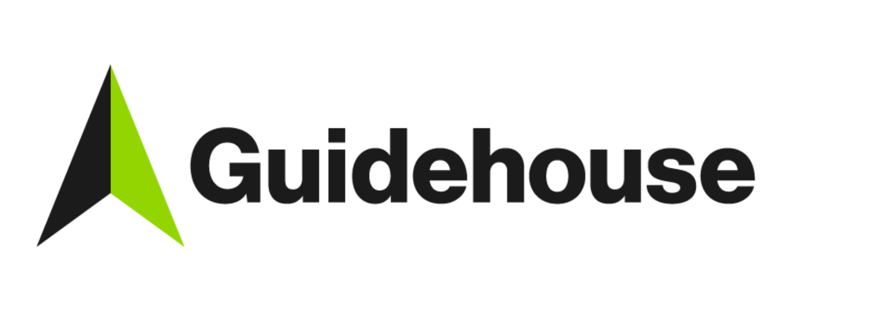





5 min | Guidehouse Welcome & introduction to Cool Up
5 min | Ӧko-Recherche Introduction to RRR schemes
15 min | MLF Secretariat Funding of RRR schemes through the MLF
10 min | NOU Egypt Country example: Status and outlook on RRR schemes
15 min | Ӧko-Recherche Practical example from the EU supermarket sector on RRR schemes
5 min | Q&A
5 min | Ӧko-Recherche Take-away messages and closing
Agenda
Subtitle here

Slide 3

Introduction to the Cool Up programme
Eslam Mahdy, Guidehouse

Slide 4
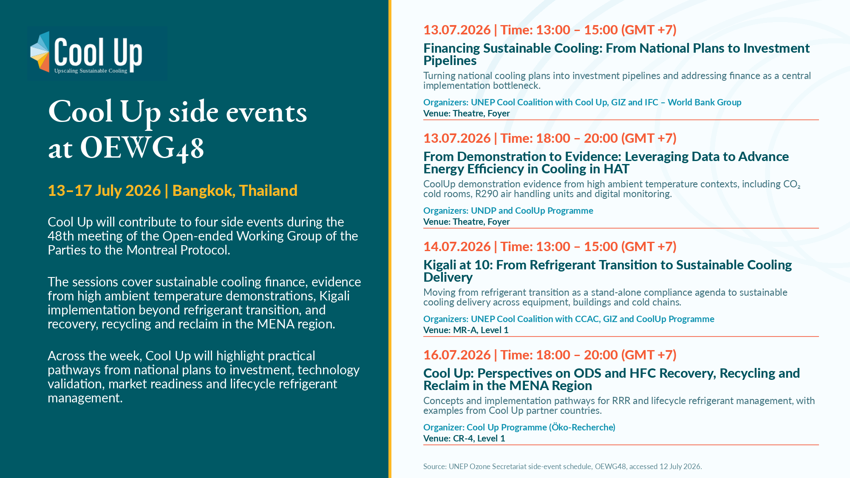

Slide 5




The Cool Up programme
Upscaling sustainable cooling
Funding:
Duration: December 2020 – January 2027
MENA countries face a range of energy challenges against the visible effects of climate change due to rapidly growing urbanisation, and heavily strained energy infrastructure.
In the region, cooling constitutes a major source of energy consumption, and it is expected to grow further. The Cool Up programme promotes accelerated technological change in cooling demand reduction, and early implementation of the Kigali Amendment and Paris Agreement in Egypt, Jordan, Lebanon and Türkiye.

Slide 6
Four pillar approach
Reducing cooling demand
Supporting the phase-down of hydrofluorocarbons (HFCs)
Replacing and safely disposing inefficient cooling appliances and refrigerants
Improving cooling appliance operation, training, and awareness
This approach is supplemented by setting up implementation-focused industry partnerships and building hands-on capacity to enable local and regional stakeholders. Findings of replicable demonstration projects will be used to disseminate knowledge.

Slide 7
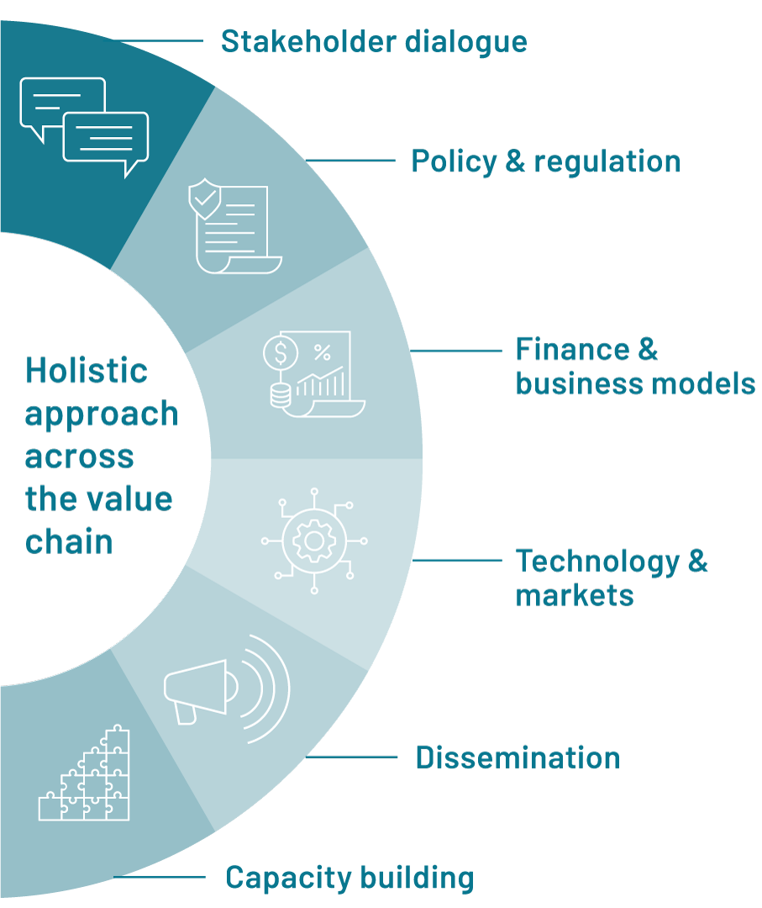
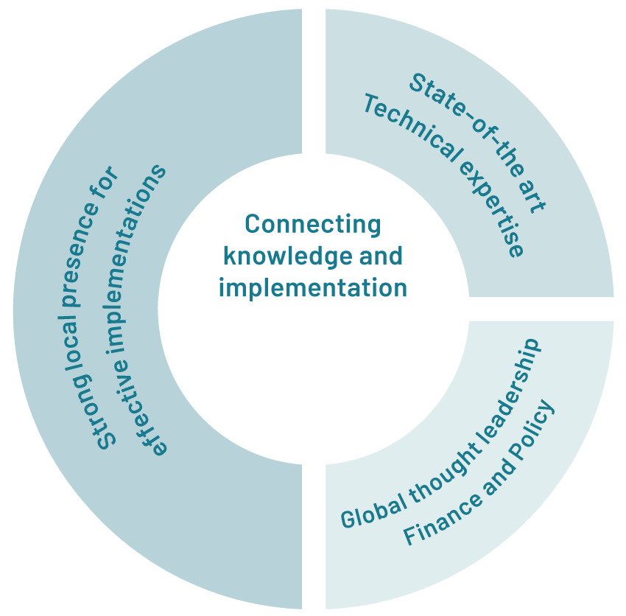





Cool Up has a multi-level, multi-sectoral approach across the value chain
10 partners bring in their specific expertise

Slide 8
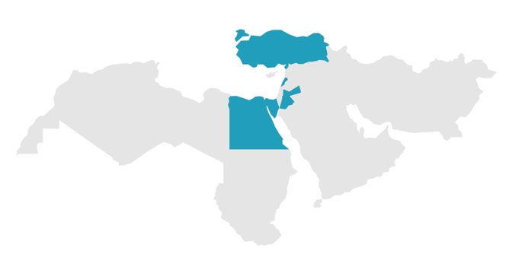




Goal of the Cool Up programme
Challenges
Rapidly growing cooling & final energy demand
Structural energy sector challenges
Regional multiplicators for learning between countries, in the region and beyond
Impacts
Add to ongoing efforts for building efficiency, climate mitigation and adaptation
Strong political and working-level network
Four partner countries as action hubs
Türkiye
Lebanon
Egypt
Jordan

Slide 9
Introduction to the RRR schemes
Barbara Gschrey, Öko Recherche

Slide 10
Definitions: Recovery, Recycling and Reclamation
Refrigerant management activities are grouped under recovery, recycling and reclamation.
Recovery refers to the extraction of refrigerant from equipment without treatment.
Recycling involves the removal of contaminants such as oil, moisture and particulates to enable reuse under controlled conditions.
Reclamation refers to advanced testing & processing that restores refrigerant to virgin-equivalent quality.

Slide 11
RRR is one chain — but three different operations
Recovery
Recycling
Reclaim
Disposal
Extract refrigerant from equipment
without treatment
Basic cleaning: oil, moisture, particles
Advanced processing + testing to defined specifications
In case gas or mixture is too contaminated or subject to phase-out: quantities are sent for destruction
At servicing or decommissioning
Usually for controlled reuse
Suitable for wider market use
Depends on quality and regulation
Key distinction for policy design:
Recovery creates the input stream;
Recycling and reclaim determine whether that stream becomes a useful refrigerant resource.

Slide 12
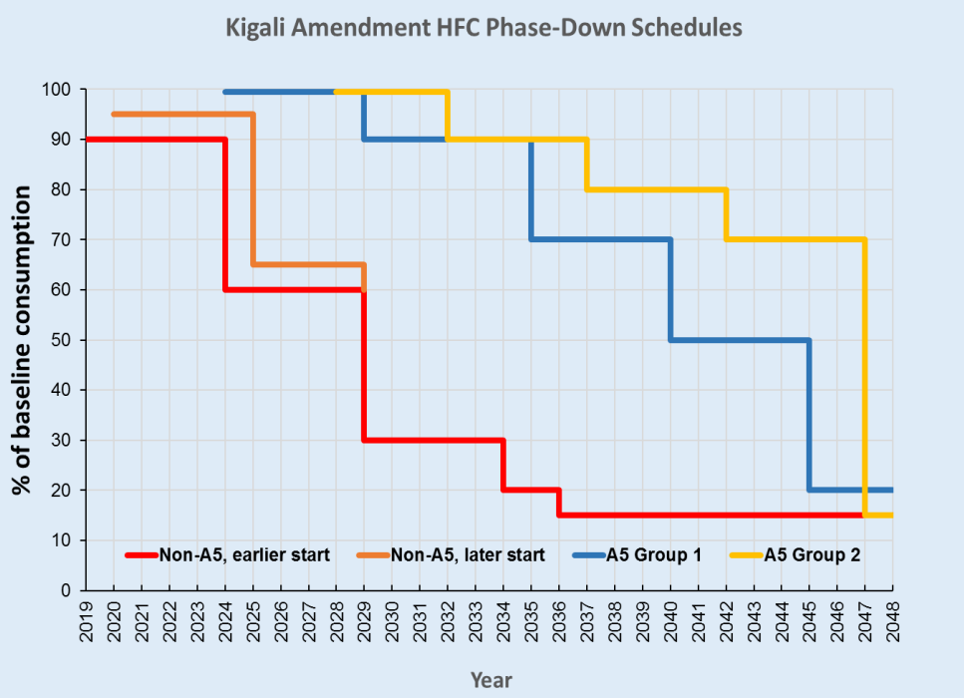
Regulatory context
International Framework
Montreal Protocol (1987) and Kigali Amendment (2016) establish global obligations to reduce emissions of ODS and HFCs
  Increasing HFC phase-down requirements make recovered and reclaimed refrigerants strategically important for supply security and emission reductions.
Source: UNEP. OzoneAction Kigali Fact Sheet No. 5 - HFC Baselines and Phase-down Timetable
EU F-Gas Regulation (EU) 2024/573
  Operators must ensure refrigerants are recovered during servicing, maintenance and decommissioning of refrigeration, air-conditioning and heat pump equipment Recovered refrigerants must subsequently be recycled, reclaimed or destroyed
  Recovered F-gases may only be used for filling or refilling equipment after they have been recycled or reclaimed.
  Recovery activities may only be performed by certified personnel.
  The HFC quota reduction mechanism progressively restricts virgin HFC supply, increasing the market value and importance of reclaimed refrigerants.
  !! HFC phase-out (not HFC phase-down) including bans for use of recycled and reclaimed gases (service bans)

Slide 13
Funding of RRR schemes through the MLF
Federico San Martini, MLF Secretariat

Slide 14

Recovery, recycling and reclamation under the Multilateral Fund, and possible options for lifecycle refrigerant management
Side event on perspectives on ODS and HFC Recovery, Recycling and Reclaim
OEWG48
16 July 2026, Bangkok, Thailand
Multilateral Fund Secretariat

Slide 15

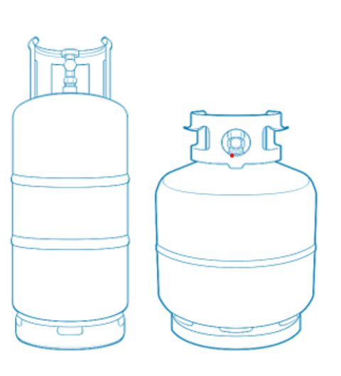
Background of Multilateral Fund support for LRM
The Multilateral Fund has long funded activities in Article 5 countries that support elements of LRM
Promotion of good servicing practices
Training and certification of RAC technicians
Support to training institutes and RAC technician associations
Training on safe handling of low-GWP alternatives, as appropriate
Infrastructure for refrigerant containment
Refrigerant recovery, recycling and reclaiming (RRR) infrastructure
Provision of tools and equipment to RAC technicians
Refrigerant leakage prevention projects
Strengthening of policy and regulatory frameworks
Development of policies, regulatory measures, and standards for refrigerant management
Licensing of workshops, introduction of labelling and record keeping requirements
Training of officers related to enforcement of regulations
These activities mostly relate to collection, transport and storage of the refrigerant while still being used

Slide 16
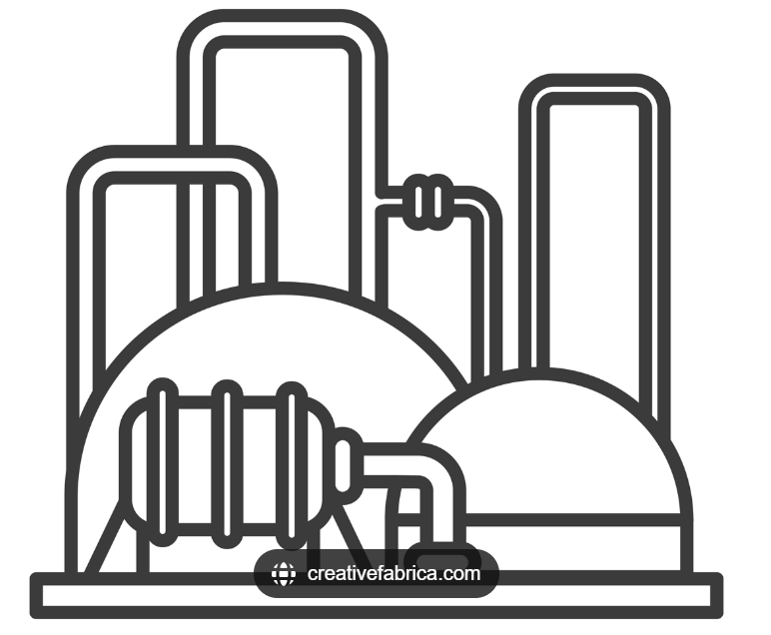
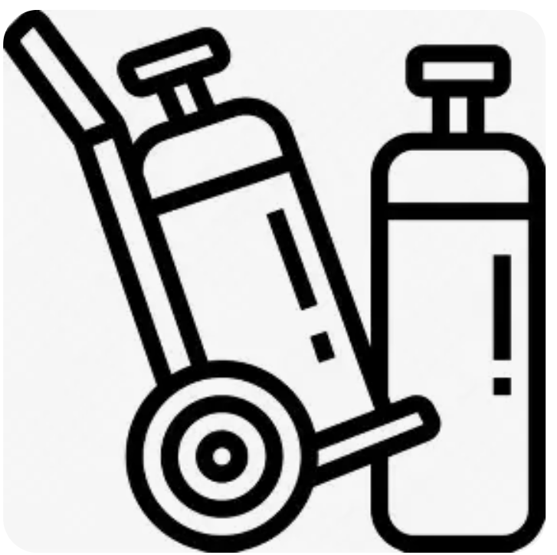
Background of Multilateral Fund support for LRM
The Multilateral Fund has long funded activities in Article 5 countries that support many but not all elements of LRM
Limited or not funded so far by the MLF:
  Limited funding provided for disposal of controlled substances
  Disposal of EOL equipment that contained controlled substances (i.e., need for link to country’s waste management policies and regulations)
  Design of equipment to maximize refrigerant containment/minimize leaks
  Tools for predictive maintenance
Funding for development of inventory of banks of used or unwanted controlled substances and a plan for the collection, transport and disposal of such substances contained in document (decision 91/66)
  Projects approved for 127 A5 countries
  To be completed between December 2025 and December 2027

Slide 17
Relevant decisions
Meeting of the parties
Decision XXVIII/2(24): ExCom to consider funding the cost-effective management of stockpiles of used or unwanted controlled substances, including destruction
Decision XXXV/11(4): ExCom to consider a window of funding for countries that completed their national inventories and plans in accordance with ExCom decision 91/66 to support the implementation of the plans
Executive Committee
Decision 90/49(b): Flexibility for Article 5 countries to include, in HPMPs or KIPs, activities related to the environmentally sound management of used or unwanted controlled substances
Decision 91/66: Criteria for funding preparation of inventories and development of plans
Decision 93/104: Secretariat to prepare for consideration by ExCom at 97th meeting a report providing:
  An overview of the report of the TEAP and the outcomes of the workshop that would be held in line with decision XXXV/11 of the 35th MOP;
  Status of implementation and preliminary outcomes of the projects submitted under decision 91/66 with a view to considering the establishment of a funding window in line with decision XXXV/11

Slide 18
Relevant decisions (2)
Executive Committee
Decision 97/89:
  To encourage the bilateral and implementing agencies to intensify their efforts to assist Article 5 countries in finalizing projects under decision 91/66 as soon as feasible and in submitting the final reports and a copy of the resulting national inventories and national action plans
  Secretariat to update, for the 99th meeting, the information in document 97/87 in light of completed inventory projects and national plans and other relevant information, including on the movement of controlled substances for destruction or reclamation
  Secretariat to prepare, for the 100th meeting, a document on funding modalities, including elements for draft cost guidelines to implement plans developed in accordance with decision 91/66, with a view to considering the establishment of a funding window in line with decision XXXV/11, taking into consideration the information provided in the report referred to above and the views on that report expressed by the ExCom
Decision 97/31: Not to extend the funding window established under decision 91/66

Slide 19
Ideas contained in report presented to 97th meeting
  A national strategy enabled by a robust regulatory framework tailored to each country’s context will help ensure effective and self-sustained LRM
  Enhancing leakage prevention
    Some activities initiated or already included in refrigeration servicing activities under the HPMPs and KIPs
    Improving design and installation (sometimes partially addressed in manufacturing conversions or in local assembly and installation projects)
    Lacking or inadequately addressed
      Proper disposal of EOL equipment, including refrigerant recovery
      Challenges (and opportunities) can vary by sector and refrigerant

Slide 20
Ideas contained in report presented to 97th meeting (2)
  Optimizing RRR
    Included in many HPMPs and KIPs
      Less so for reclamation
      Challenges include costly logistics, lack of adequate and enforced regulations, unresolved issues (e.g., disposal of unusable refrigerants)
    Other ideas
      Link equipment replacement with end-user incentive programmes
      Enable extended producer responsibility (EPR) schemes (see sessions 3 and 7)
      Regional approaches to reclamation

Slide 21
Ideas contained in report presented to 97th meeting (3)
  Strengthening reclamation in A5s with manufacturing
    Price of virgin refrigerant – balance viability of reclamation with risk of illegal trade
    Requirement for progressive increase in use of reclaimed refrigerant in HFC-based manufacturing
  Disposal of unwanted refrigerants
    Many challenges, e.g.,
      Need consistent and sufficient volume to justify capital expenditures needed to establish destruction facilities
      Accumulate enough controlled substances to make transport viable and justify the individual shipment transaction costs (collection, consolidation, storage)
    Mobile destruction units

Slide 22
Ideas contained in report presented to 97th meeting (4)
  Disposal of unwanted refrigerants (cont’d)
    Disposal campaigns of phased out controlled substances except halons, HCFC and HFCs
      Need to avoid perverse incentives
      Mostly relevant to LVCs and non-LVCs
    Larger non-LVCs more likely to have destruction facilities and able to generate consistent and sufficient volume of waste controlled substances
      Case-by-case basis
  Transboundary movement of controlled substances for destruction or reclamation
    Session 5 and breakout in session 6
    Possible revolving fund modality?

Slide 23
Final thoughts
  A national strategy enabled by a robust regulatory framework tailored to each country’s context will help ensure effective and self-sustained LRM
  Report presented at the 97th meeting included a number of ideas
    Consider using any that will work for your country
    Ignore any that won’t for your country

Slide 24
Country example: Status and outlook on RRR schemes
Dr. Ezzat Lewis, NOU Egypt

Slide 25


Reclamation Centers of ODS
Egypt Experience
BY
Ezzat Lewis
NOU , Egypt
Ministry Of Environment
Egyptian Environmental Affairs Agency
National Ozone Unit

Slide 26
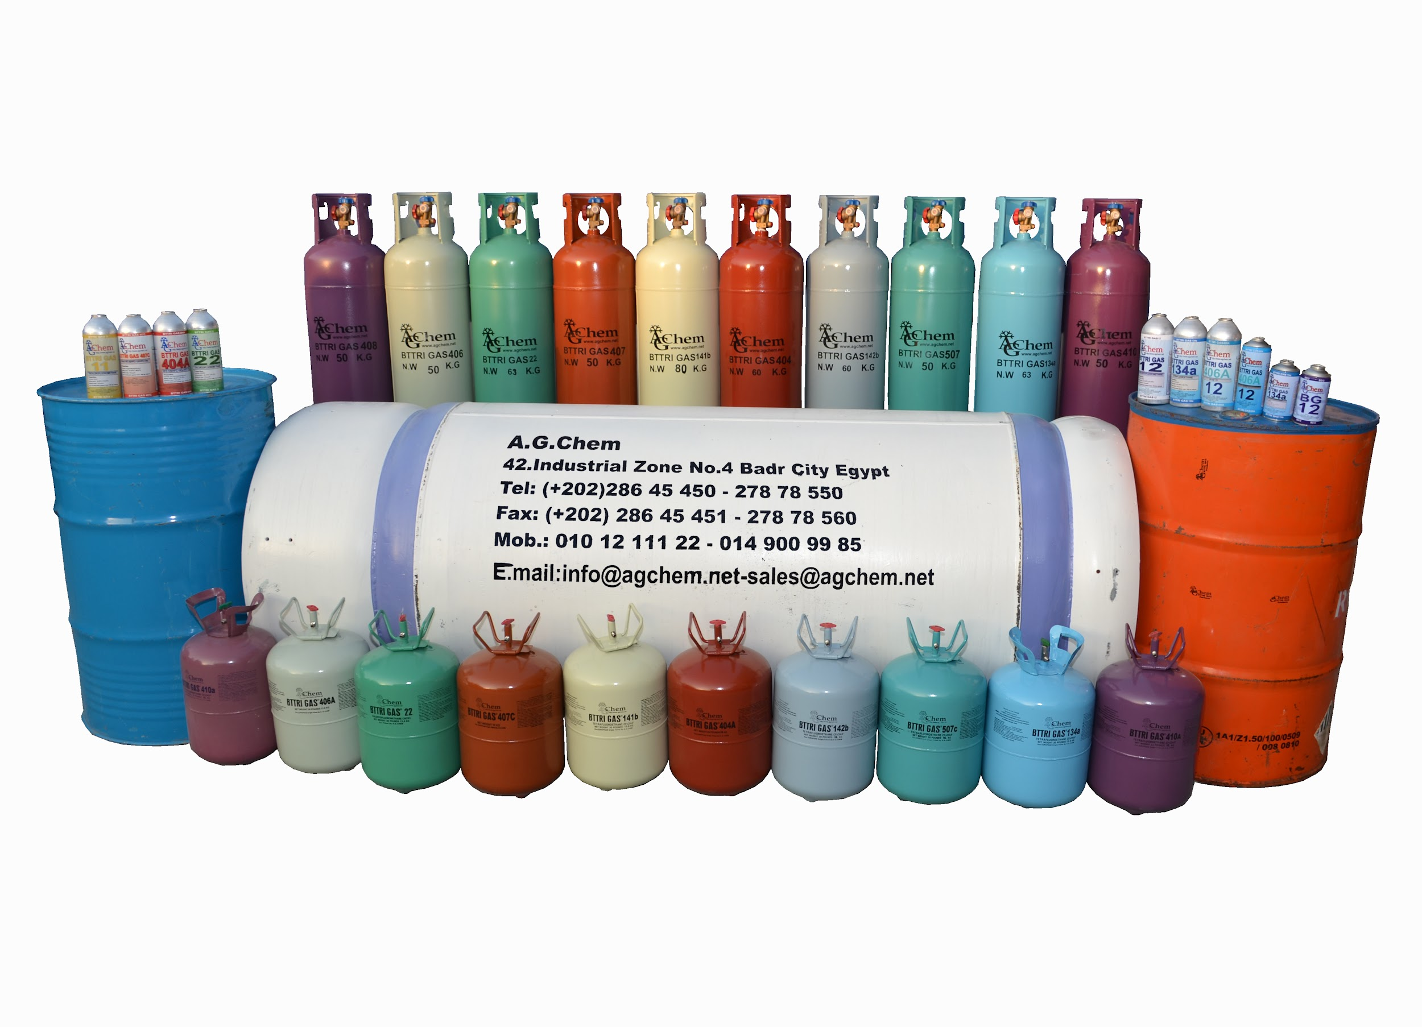

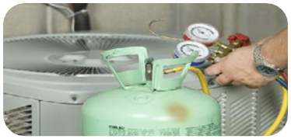


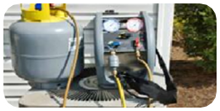
Normal Refrigerant Life Cycle
Packing / Importation
Trading
Refrigerant Charging
Incineration
Release to Atmosphere
Refrigerant Recovery / Recycle

Slide 27


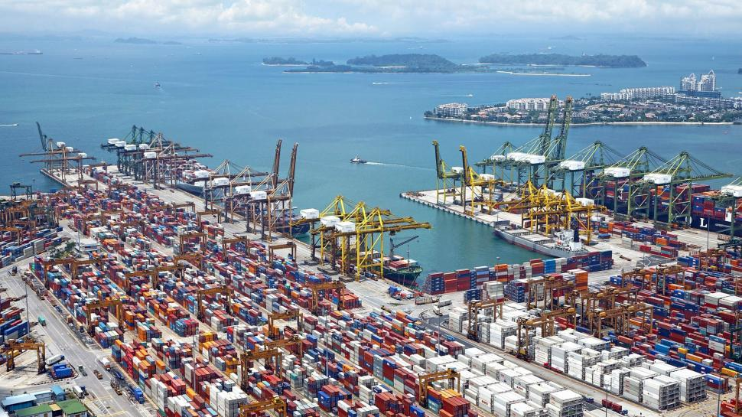
Current state of play of RRRD in Egypt
Policy and first implementation steps
Recovery of refrigerants is recognised under Egypt's Montreal Protocol implementation.
Recovery equipment has been distributed through HPMP implementation activities.
Key elements of the emerging RRRD system
Refrigerant recovery is already implemented at servicing level.
1st Reclamation center is already established, commissioned & operation is ongoing
2nd Reclamation center establishment currently underway
3rd Reclamation center: plan developed; implementation has not yet begun.
https://freerangestock.com/photos/89112/aerial-view-of-port-and-waterway.html

Slide 28
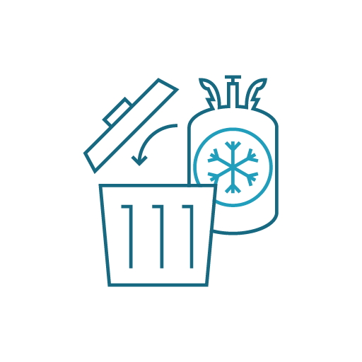
Reclamation Centre Objective
Reduce the importation/emission of ODP/GWP refrigerants,
Create awareness of the benefits of using recycled and reclaimed refrigerants in the RAC servicing sector,
The reclamation center targets the supply stability of affordable and quality refrigerants,
Reduce dependence on virgin ODS’s and high GWP refrigerants

Slide 29
Reclamation Centre & Network
RAC Industry OEM’s (RAC systems manufacturers) & their authorized service – maintenance service centers
RAC service and maintenance centers
Refrigerant distributors
RAC servicing technicians
Technical education and vocational training

Slide 30

Challenges in handling used refrigerant
Illegal venting
Insufficient incentives for recovery and collection
Illegal import of refrigerants
Reduction of emissions caused by manufacturing & transport.
Virgin product market price volatility
Insufficient waste management services
Lack of an Extended Producer Responsibility system
Reducing the consumption

Slide 31
Completed Activities
Project details and implementation overview.
Visits conducted to a Foreign Factory and equipment suppliers.
Ordering and procurement of the required equipment.
Delivery, Installation and commissioning of the equipment.
Contracting authorized Hub Terminals.
Supplying equipment to the Hub Terminals.
Training Hub technicians.
Preparing and conducting territory training for Recovery and using Reclaimed Gas.
Initiating refrigerant reclamation operations according to AHRI 700 Standard 2024 (SI).

Slide 32
Pilot Reclamation Center Project Overview
Project Duration:
  18 Months
Project Scope:
  HCFC’s (R-22) Recovery & Reclamation.
Project Resources:
  R-Bank (separate building in facility)
  Recovery Cylinders Fleet
  Recovery Machines & Tools
  Reclamation Machines
UNIDO
Project Owner
RRR
AGCHEM
Project Contractor
EEAA NOU
Project Supervision

Slide 33
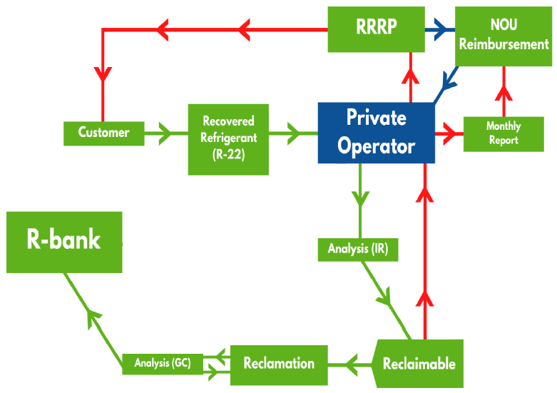
R-Bank

Slide 34
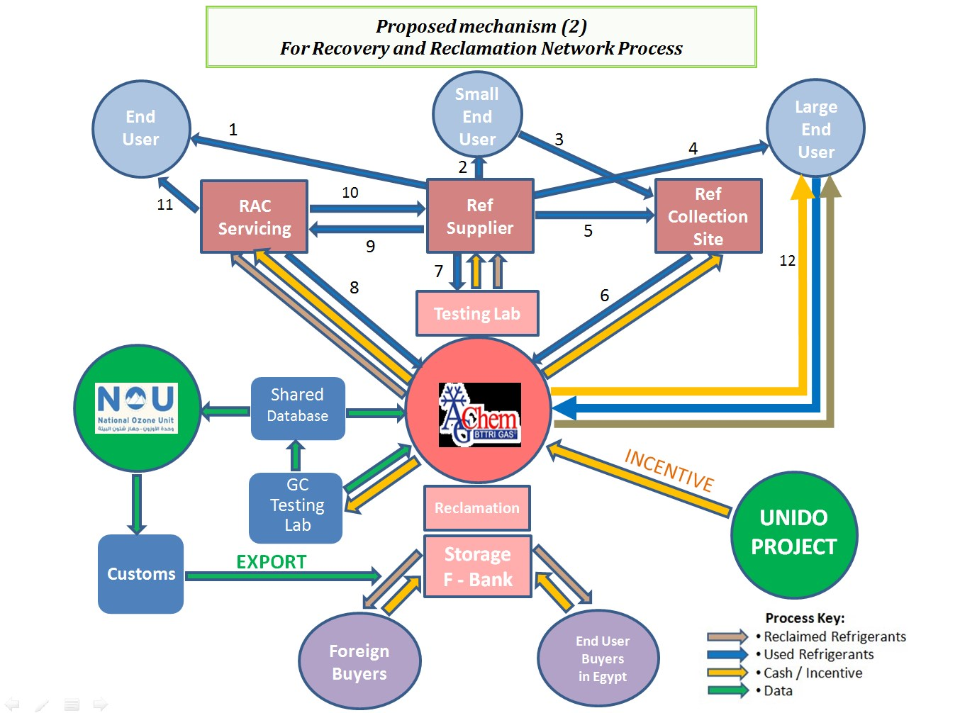

Slide 35

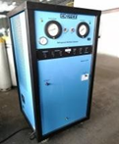
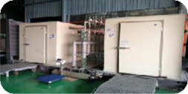
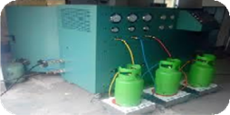

Reclaimed Refrigerant Life Cycle Management
Packing / Importation
Vestibulum congue tempus
Analysis
Trading
Vestibulum congue tempus
Vestibulum congue tempus
Reclamation Process
Refrigerant Charging
Vestibulum congue tempus
Vestibulum congue tempus
Refrigerant Transfer
Ref. Recovery / Recycle
Vestibulum congue tempus
Vestibulum congue tempus
Incineration
Analysis
Deliver to AGChem
Vestibulum congue tempus
Vestibulum congue tempus
Vestibulum congue tempus

Slide 36
Outlook
Priority Actions for the Next Phase
Complete the establishment and commissioning of the first refrigerant reclamation facility.
Develop national guidance for the environmental impact assessment of refrigerant recovery, recycling and reclamation facilities.
Prepare a report on best practices to support the implementation of the first reclamation facilities.
Use the experience gained to inform future implementation of RRRD activities in Egypt.

Slide 37
Thank You
http://www.eeaa.gov.eg
http://www.cdm-egypt.org
Ozone.egypt@gmail.com
Facebook page : ozone unit-Egypt

Slide 38
Practical example from the EU supermarket sector on RRR schemes
Barbara Gschrey, Öko Recherche

Slide 39
Cool Up Study on RRR: Experiences from the EU Supermarket sector and applicability in A5 countries
NOU Egypt initiated Cool Up support on practical RRR options for sustainable cooling in the country.
Work includes an RRR study and guidance for environmental impact assessment of RRR activities.
Evidence base: structured, non-confidential consultations with EU retailers, technology experts and sector experts.
Focus: implementation models, service partners, cylinder logistics, quality control, documentation and transferability.
Findings are generalised and exclude confidential business or commercially sensitive information.

Slide 40
Overall goal: Enabling controlled refrigerant flows from recovery to reuse, reclamation or destruction
HFC reduction schedule since 2015 and mandatory recovery, recycling/reclaim
Study levels concerned and guiding questions
Operator level
How retailers and wholesalers organise recovery across sites
Supply-chain level
How service partners and refrigerant companies make the system work
TRANSFER
What can be simplified for emerging RRR systems

Slide 41
Structure of the interviews
Starting Point & Internal Organization
Drivers for introducing refrigerant recovery and recycling
Internal ownership and governance structures
Development pathway (pilot projects vs. direct rollout) and documentation of experiences
Collaboration with Service Partners
Roles of refrigeration contractors and service providers
Adaptations to maintenance contracts, technical specifications, and operational procedures
Logistics & Operational Implementation
Processes for refrigerant recovery, collection, transport, and return
Use of refillable containers and associated practical challenges
Coordination through central/regional hubs or service partner networks
Quality Assurance & Documentation
Decision criteria for reuse, recycling, redistribution, or disposal
Minimum monitoring, tracking, and documentation requirements
Lessons Learned & Transferability
Key implementation barriers and success factors
Recommendations for countries where recovery and recycling infrastructure is still developing
(Optional) Viable scale requirements and potential pilot project approaches

Slide 42
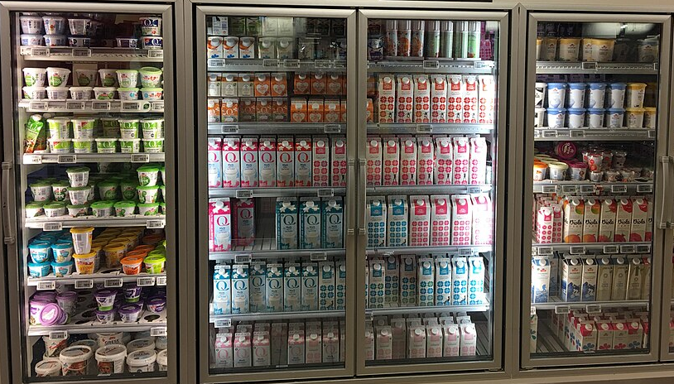
Looking back: Why EU retailers started to organise refrigerant recovery
In the EU, the driver was not technology alone. It was a combination of regulatory pressure, refrigerant availability, and operational risk.
Regulation
F-gas phase-down and service bans made high-GWP refrigerants a strategic risk.
Price signal
Quota constraints and higher prices increased the value of recovered refrigerants.
Supply security
Operators wanted access to refrigerant for remaining equipment until replacement.
Asset planning
Recovery links to retrofit schedules, leakage management and phase-out plans.
Notes:
Service bans:

Slide 43


Details on EU service bans
In addition to bans of the use of fresh F-gas refrigerants in new and existing equipment, the following rules apply:
For any refrigeration equipment:
Use of recycled and reclaimed refrigerant with GWP>2500 is prohibited from 1 January 2030.
For air conditioning equipment and heat pumps:
Use of recycled and reclaimed refrigerant with GWP>2500 is prohibited from 1 January 2032.
Full ban of R404A and R507
No restrictions for recycled and reclaimed gases with GWP <2500

Slide 44
The practical model: a controlled refrigerant bank
Core ideas
recovered refrigerant remains “visible” as an operator resource,
existing service and supplier relationships are used instead of building a new parallel chain.
Store / site
Recovery
Distributor / service partner
Recycling / reclaim
Refrigerant bank
Service or retrofit
Cylinder filled
Analysis + aggregation
Quality route selected
Returned to operator pool
Interview key finding: the system works when accounting, cylinder flows and responsibilities are clear — not because every operator owns a recycling plant.

Slide 45

What makes the system operational
1
Refrigerant inventory
Assessments on stocks, leakage, retrofit plans and expected service demand (equipment database).
2
Service rules
Obligatory recovery, cylinder use and documentation in service routines.
3
Cylinder logistics
Usage of refillable cylinders, return loops and clear ownership/accounting.
4
Quality decision
Analyses on recovered refrigerant and decision on future route: reuse, recycling, reclaim or destruction.
5
Timing buffer
Storage of sufficient quantity (e.g. plus 40%) because recovered volumes return later than peak refill demand.

Slide 46
Refrigerant inventory 1/2
Expected Refrigerant Demand – What information is needed?
Current stock (equipment database)
  Which systems are still in operation?
  Which refrigerants are used, and in what charge sizes?
  Which systems are high-risk due to age, leakage or failures?
  Future servicing needs
  How much refrigerant will be needed before systems are replaced?
  Which refrigerants remain critical for legacy equipment?
  When will demand peak during the servicing season?
Planning relevance
Identifies future supply risks
Helps plan buffer stocks
Links RRR to asset management

Slide 47
Refrigerant inventory 2/2
Matching Demand with Recovered Refrigerant Flows
Recovery potential
  Which systems will be retrofitted or decommissioned?
  How much refrigerant can realistically be recovered?
  What share is likely to return as usable recycled or reclaimed refrigerant?
Planning insight
Operators need to compare future demand with expected usable return flows.
Buffer stocks may be needed because recovered refrigerant often returns later than demand occurs.

Slide 48

Economic logic
The value of the RRR scheme depends on volumes, timing and trust
Cost side
Value side
Recovery adds labour during service, retrofit or decommissioning.
Cylinders must be available, labelled, tracked and returned.
Transport costs rise when volumes are small or dispersed.
Analysis, recycling, reclaim and destruction add processing costs.
Mixed or contaminated refrigerant
Recovered refrigerant reduces demand for virgin supply.
Recycled or reclaimed refrigerant supports servicing of existing equipment.
A refrigerant pool improves supply security.
Transparent accounting builds trust in origin, quality and usability.
The business case improves when volumes are aggregated, returned and managed refrigerant pool.

Slide 49
EU experience translated into a A5 starting model
Start with the simplest model that can generate real refrigerant flows and data.
Do first
Focus on recovery discipline, refillable cylinders, documentation and service-provider routines.
Avoid
Assuming that a reclaim plant alone creates the system.
Build on current relationships with service firms and refrigerant distributors.
Avoid
Designing a complex national scheme before logistics and data are tested.
Use existing actors
Pilot with large users
Start where volumes and assets are concentrated. → In A5 countries mostly the AC sector (unlike in EU!)
Avoid
Ignoring incentives for technicians, service firms and operators.
For getting the model started,
simple, enforceable processes are relevant.

Slide 50

Takeaways for designing RRR schemes
Equipment alone does not create an RRR system.
1
A price or compliance signal is needed to make recovery valuable.
2
Service companies and distributors are the operational backbone.
3
Purity, documentation and cylinder control determine whether value is preserved.
4
For emerging systems, pilots should start with concentrated users and simple closed loops.
5
Conclusion: RRR schemes should be built as refrigerant management systems.

Slide 51
Q&A

Slide 53
Disclaimer:
This document is a draft and provided as a courtesy. This document is not to be considered as final, and all information contained herein is subject to change upon further review by the Cool Up programme.
Guidehouse is not responsible for any images or text used by partners and subcontractors in the distribution of Cool Up materials.
coolupprogramme.org | info@coolupprogramme.org

