Slide 1
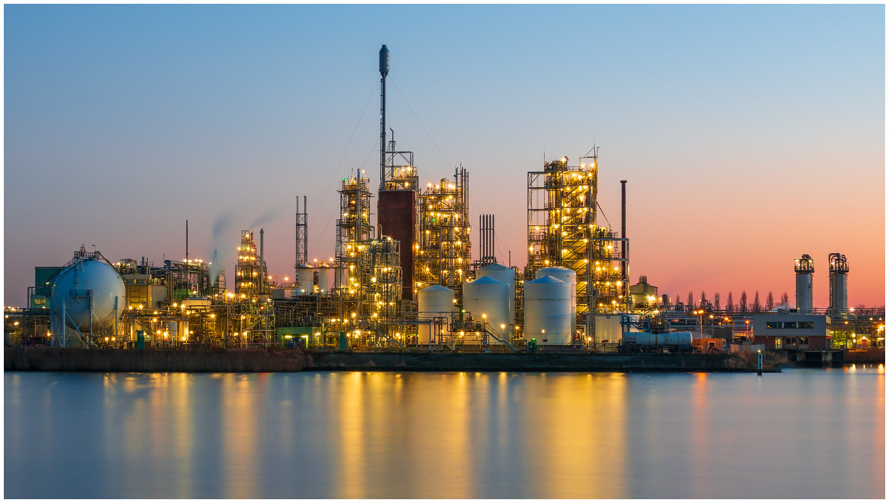
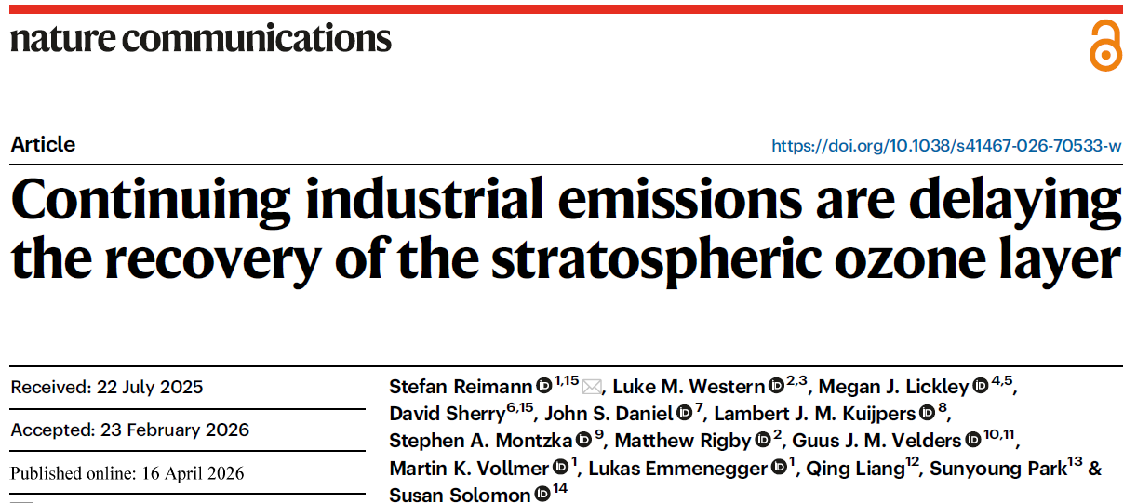
Industrial Emissions of Ozone-Depleting Substances are Delaying the Recovery of the Stratospheric Ozone Layer
Stefan Reimann, Stephen A. Montzka et al.
The Accra-Helsinki Group for Sustainable Cooling Side Event
OEWG 2026
Notes:
The volume of current and future feedstock emissions are discussed in a paper which was published in Nature Communications some months ago.

Slide 2
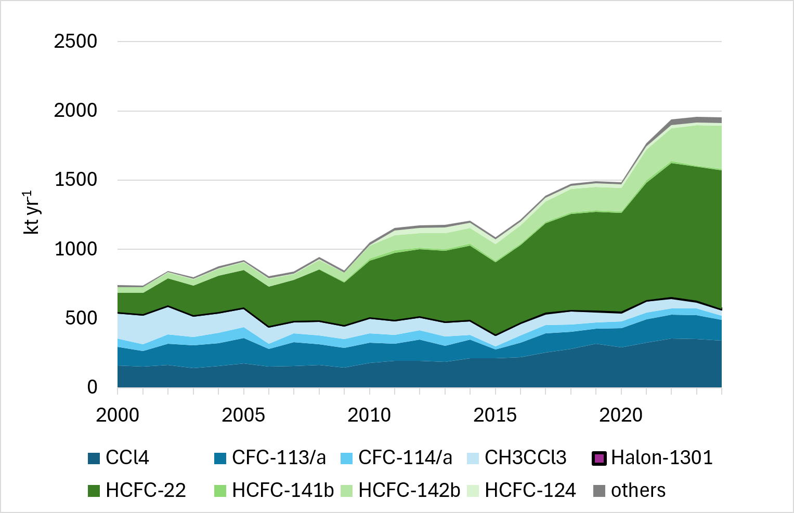
Production of ODS feedstocks in kt per year
2000-2024
+160%
2014-2024
+5% per year
Notes:
In blue colors are production of strong CFCs and chlorinated solvents; in green production of HCFCs.
The volume of production increase by 160% by mass. The increase in mass is lead by HCFC-22 for the PTFE and other polymer production.

Slide 3
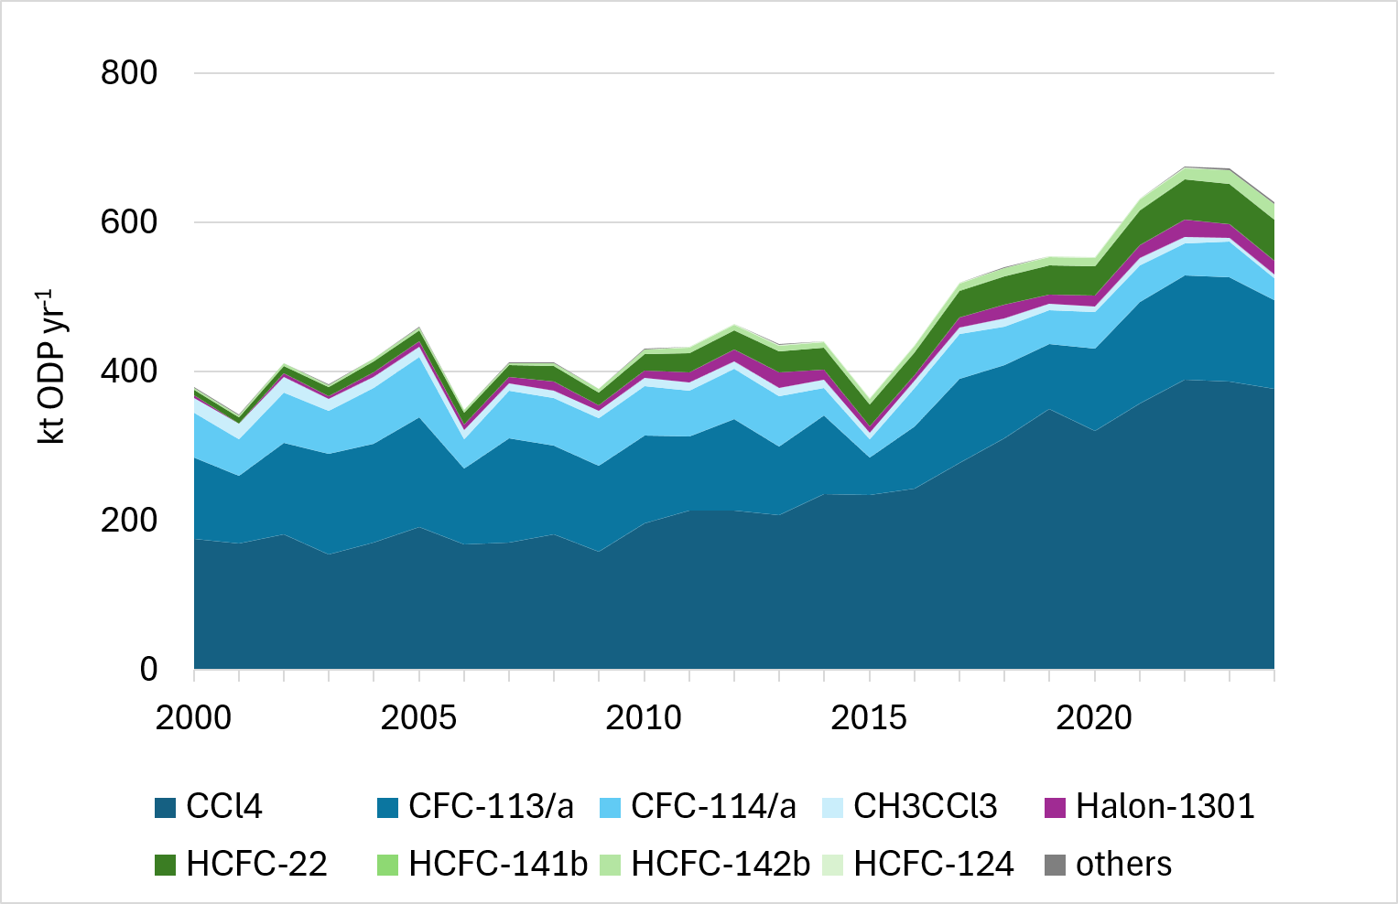
Production of ODS feedstocks in ODP-kt per year
2000-2024
+65%
2014-2024
+3.4% per year
2000-2024
+160%
2014-2024
+5% per year
ODP-kt yr⁻¹
Notes:
The same message that production of feedstocks increased but shown as ODP-kt. Here the increase is more prominent as importnat ODSs such as CCl4 (for HFOs) and CFC-113/a for polymers and base chemicals increased.

Slide 4
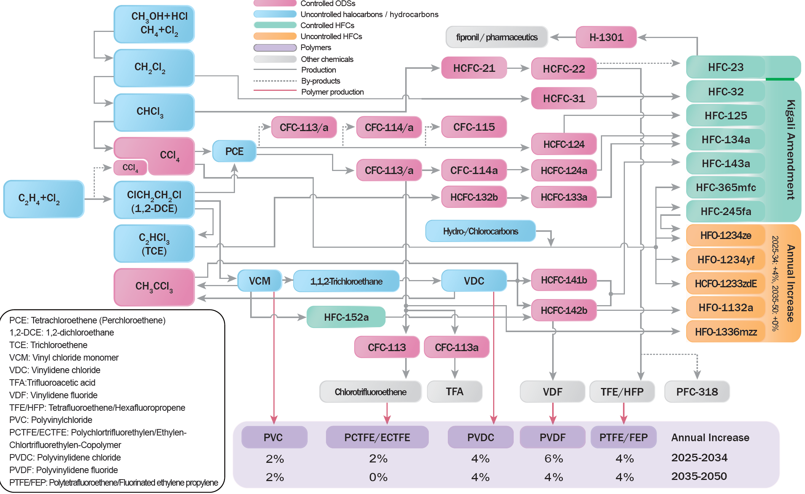
Usage of ODSs as feedstocks: A plethora of applications
gases
foaming
cooling
medical
fire
polymers
construction
packaging
Notes:
This is shown quickly just to see that many ODSs are used for different purposes. Maybe follow CCL4 to HFOs and 113/a to polymers

Slide 5
Copenhagen 1992 Article 1: Definitions
Decision IV/12: Clarification of the definition of controlled substances
1. That insignificant quantities of controlled substances originating from inadvertent or coincidental production during a manufacturing process, from unreacted feedstock, or from their use as process agents which are present in chemical substances as trace impurities, or that are emitted during product manufacture or handling, shall be
considered not to be covered by the definition of a controlled substance contained in paragraph 4 of Article 1 of the Montreal Protocol;
2. To urge parties to take steps to minimize emissions of such substances, including such steps as avoidance of the creation of such emissions, reduction of emissions using practicable control technologies or process changes, containment or destruction;
3. To request TEAP:
(a) To give an estimate of the total emissions resulting from trace impurities, emission during product manufacture and handling losses;
(b) To submit its findings to the OEWG not later than 31 March 1994.
Notes:
Here we go to the history and see why and when the feedstocks were excluded. Focus on the red sections. No need to read everything.

Slide 6
Nairobi 1994 OEWG, Tenth Meeting,
Executive Summary of TEAP 1994
ES.6 Inadvertent Emissions
A worst case estimate for the current emissions from the inadvertent production and process emissions of CFCs, CCl₄, 1,1,1-trichloroethane, HCFCs and CH₃Br is approximately
7,200 ODP-tonnes in 1994.
It is estimated that this will reduce to a worst case emission of
5,800 ODPtonnes in the year 2000. …
…Those figures were broken down by source of emission in chapter 9 of the Panel's report.
Notes:
This is the short answer from TEAP at the OEWG 1994 meeting

Slide 7
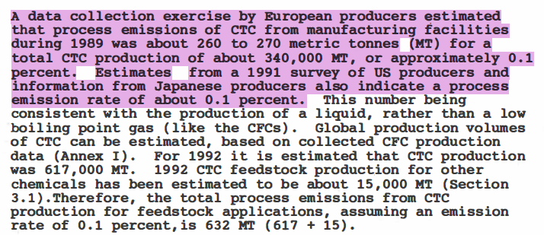
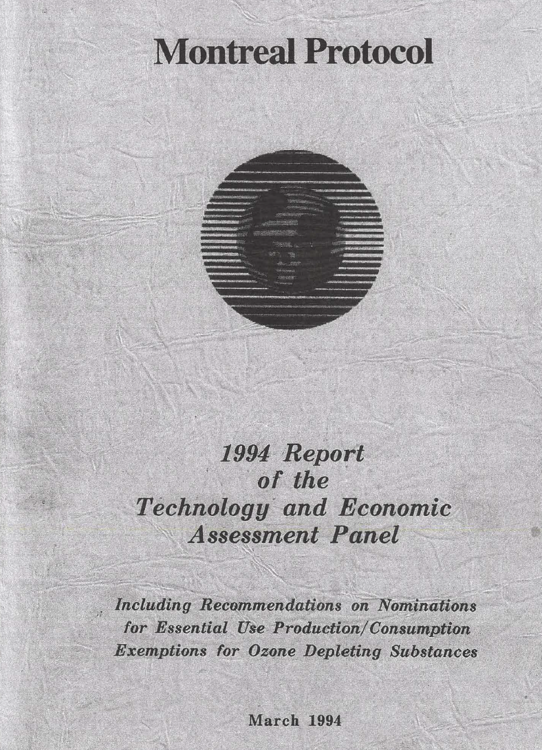
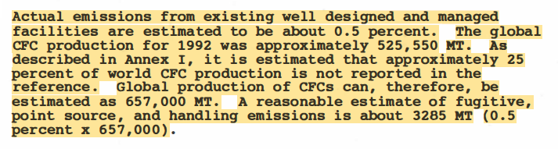
TEAP Report 1994 Chapter 9
CCl₄ (CTC)
TEAP report
Emissions Production/Use
1992: 2000:
4'872 ktODP 2'543 ktODP
OEWG
1994: 2000:
7'200 ktODP 5'800 ktODP
CFCs
Notes:
Here in Chapter 9 of the 1994 TEAP report emissions are specified as 0.1% for CCl4 and 0.5% for CFCs, which is the justification for the numbers mentioned at the OWEG. There numbers were increased by around 50% in 1992 and more than 100% in 2000 to be on the safe side.
Fact at the side: This Chapter is not part of the openly accessible collection of TEAP reports.

Slide 8
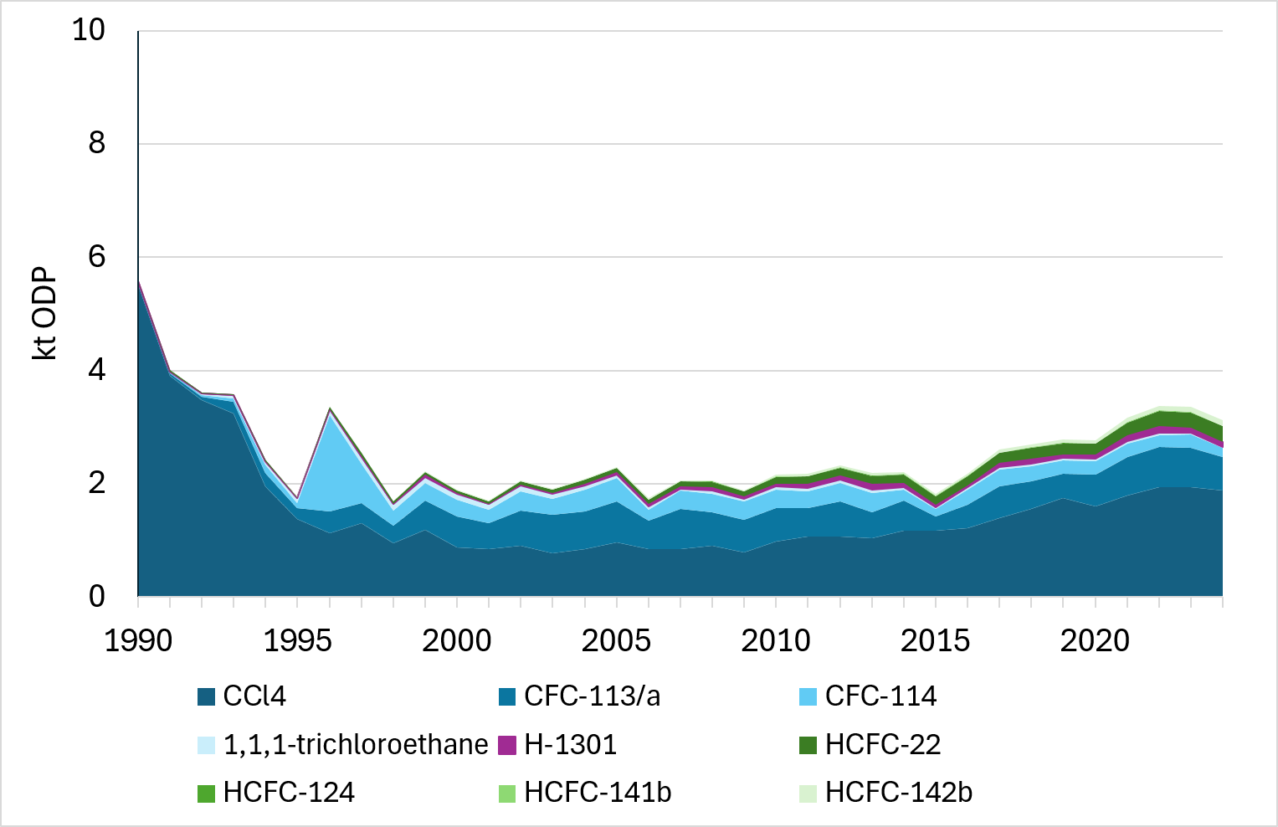
Feedstock emissions with a 0.5% (0.1% CCl₄)emission ratio
ODP-kt yr⁻¹
Notes:
Actual emissions in 1992 were a lower than estimated by TEAP, using the 1992 production volumes and 0.5%, resp 0.1% emissions. If these % are extended to the presentODP kt emissions would be quite small.

Slide 9
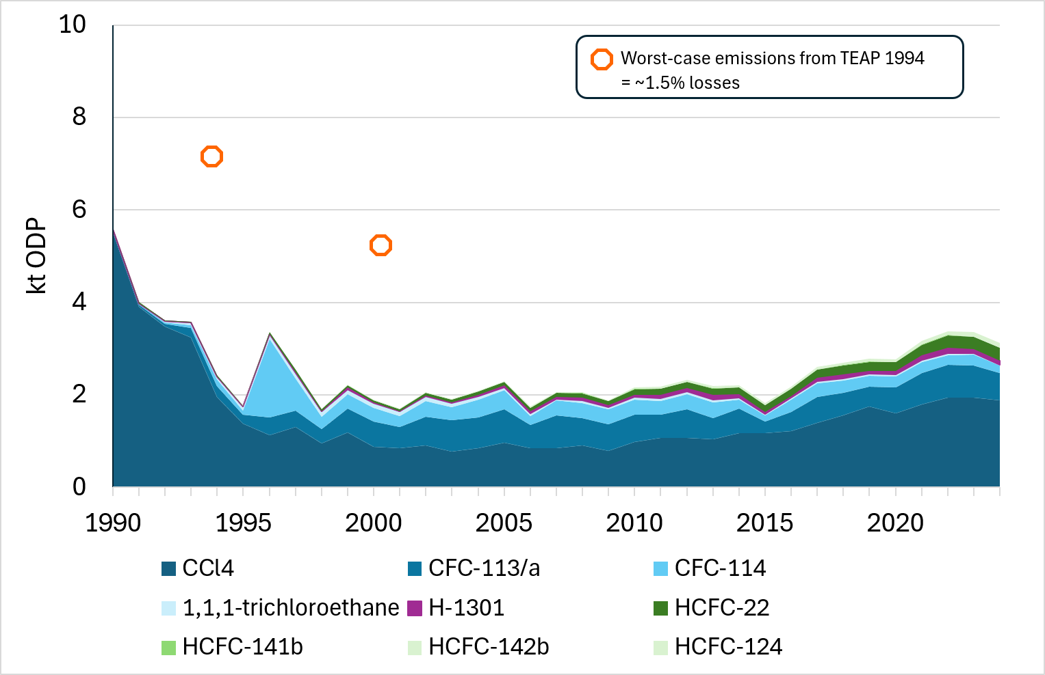
Feedstock emissions with a 0.5% (0.1% CCl₄)emission ratio
ODP-kt yr⁻¹
Notes:
The Maximum calculated by TEAP would represent about 1.5% of emissions at that time.

Slide 10
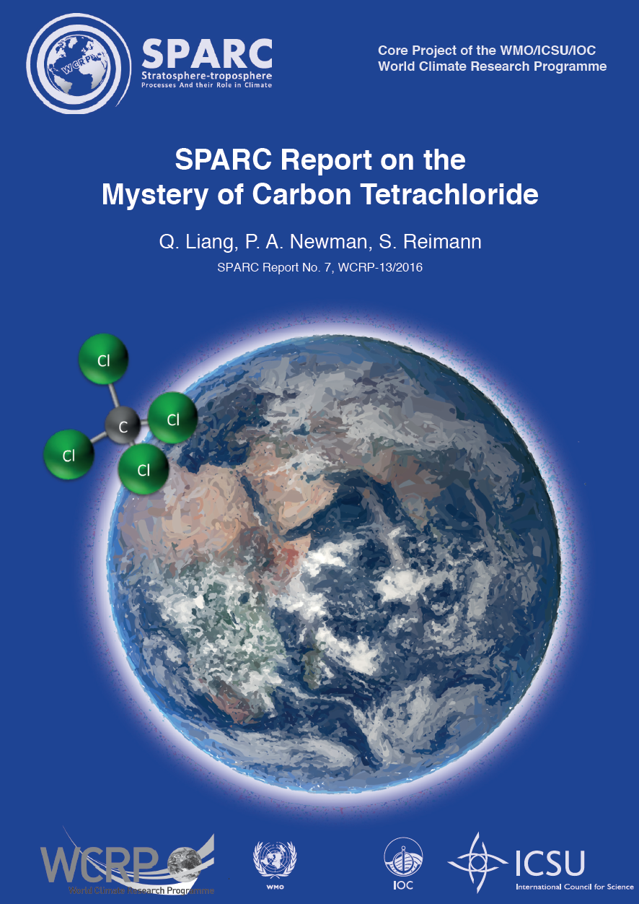
CCl₄ : on-going elevated emissions raise concerns
Simmonds et al. (J. Atmos. Chem,1988)
Suggested emissions of 1.5% during CCl₄ production
Ozone Assessment 1998/2002
Indications that emissions from feedstock production/use are >> 0.1%
Ozone Assessment 2006:
"Global budget is poorly understood"
Ozone Assessment 2010/2014:
"CCl₄ is not decreasing as rapidly as expected"
2016: Report on the Mystery of Carbon Tetrachloride (SPARC)
Notes:
Specify CCl4 as case study

Slide 11
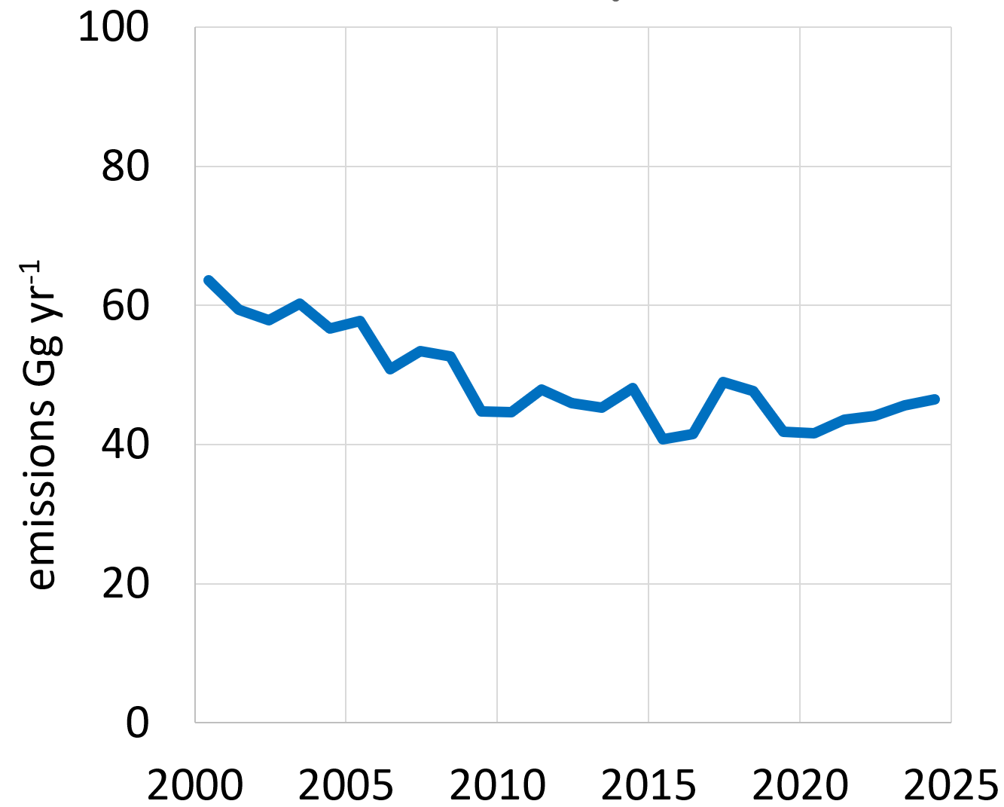
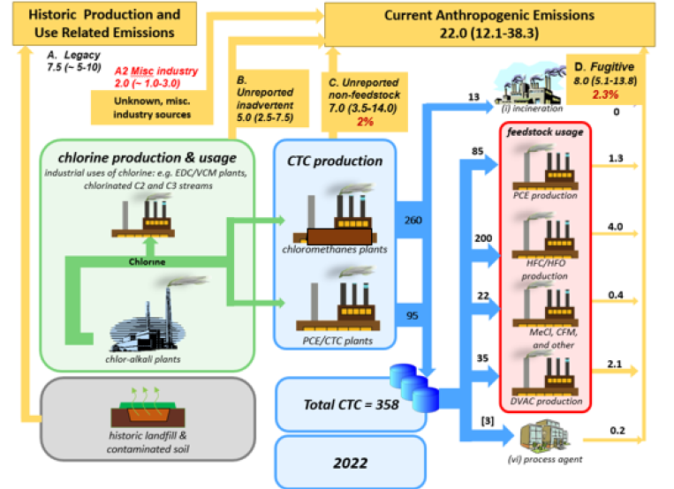
CCl₄: Mystery Emissions
Global Emissions
Feedstock Uses
4.3% Losses
Notes:
First a view on the emissions and then:
In the TEAP report 2024 losses were finally specified at 4.3%

Slide 12
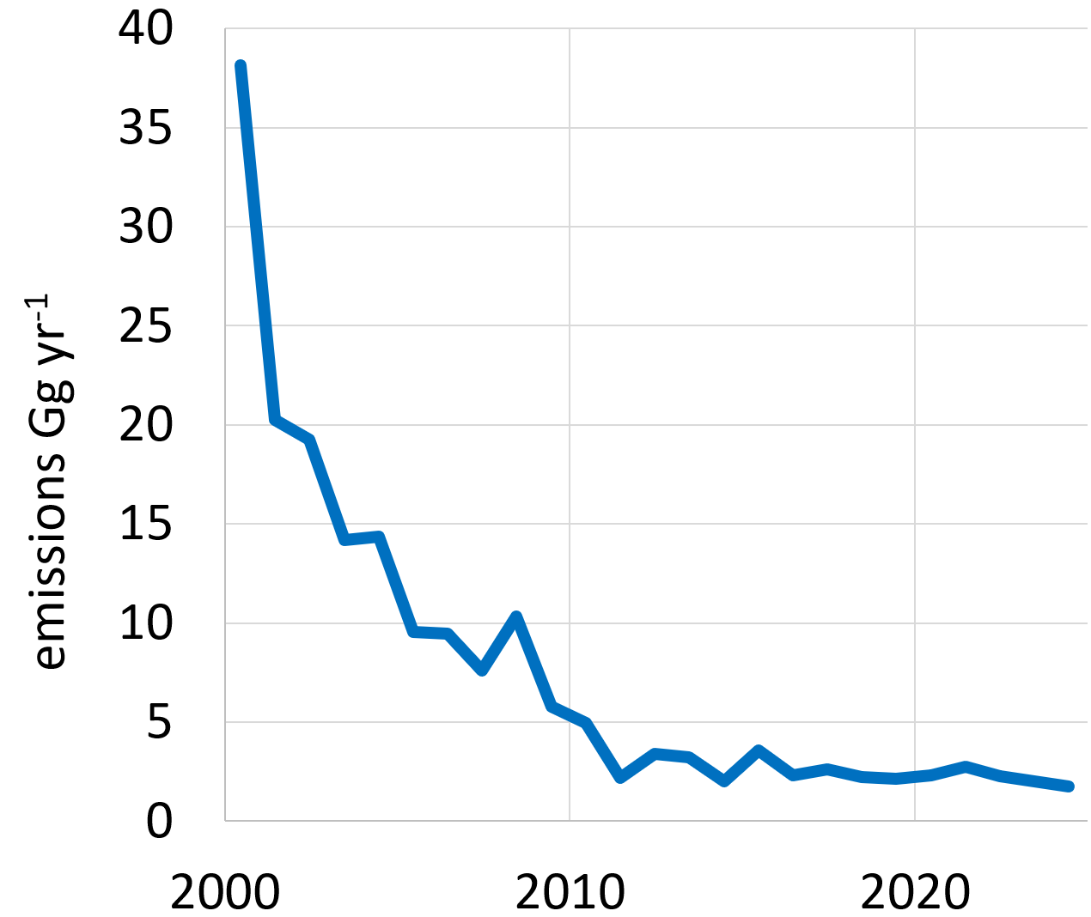
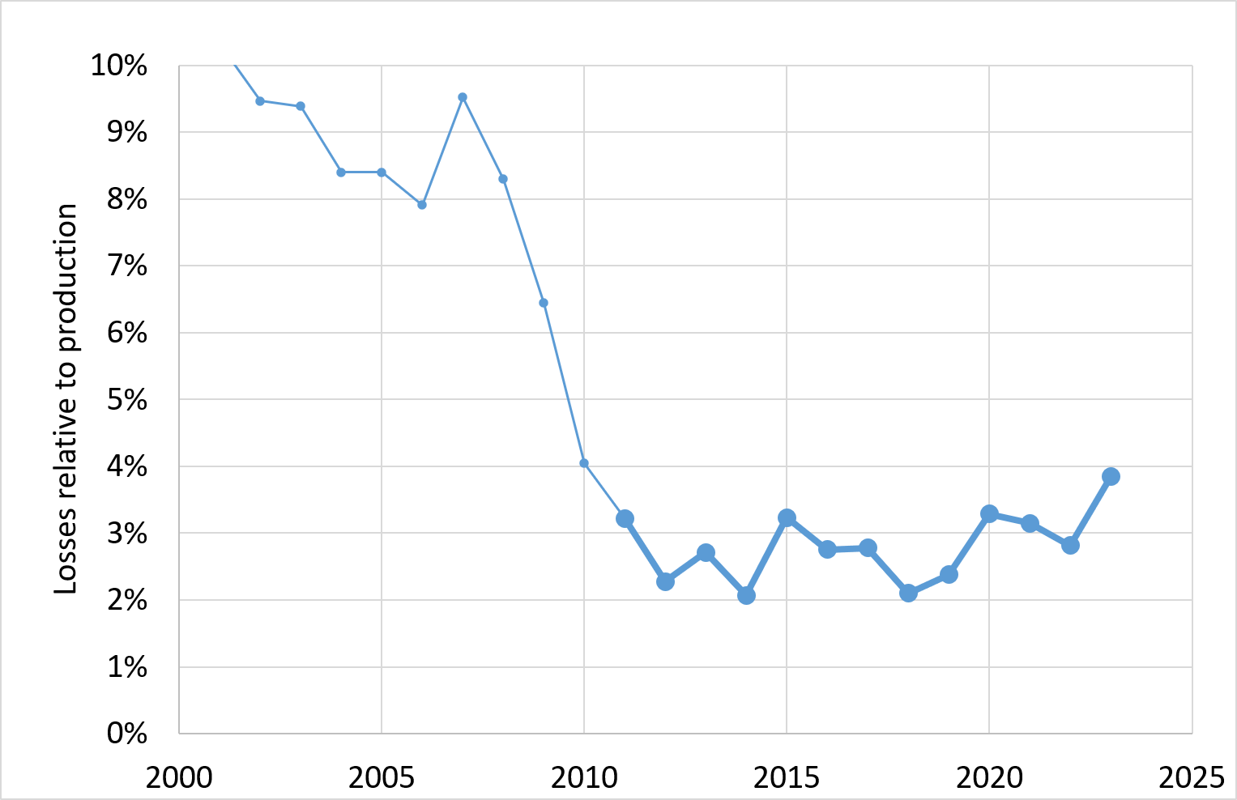
On-going emissions of other ozone-depleting substances
1,1,1-trichloroethane (CH₃CCl₃, solvent and feedstock)
Global Emissions
Losses from Feedstocks
Montreal Protocol cut
Ozone Assessment 2022
Notes:
Also for 1,1,1-trichloroethane emissions are on-going but on a very small level, which represent 2-4% of the feedstock production. This was the conclusion of the 2022 Ozone Assessment.

Slide 13
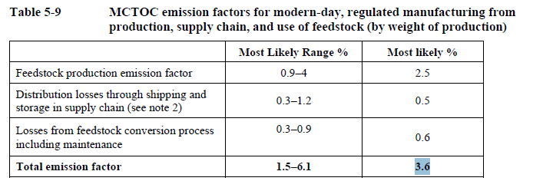
On-going emissions of other ozone-depleting substances
1,1,1-trichloroethane (CH₃CCl₃, solvent and feedstock)
Global Emissions
Losses from Feedstocks
Montreal Protocol cut
3.6% TEAP 2024
Ozone Assessment 2022
Notes:
In the following TEAP revised the relative feedtock emissions to 3.6% (1.5-6.1%) as a default value for feedstocks except CCl4.

Slide 14
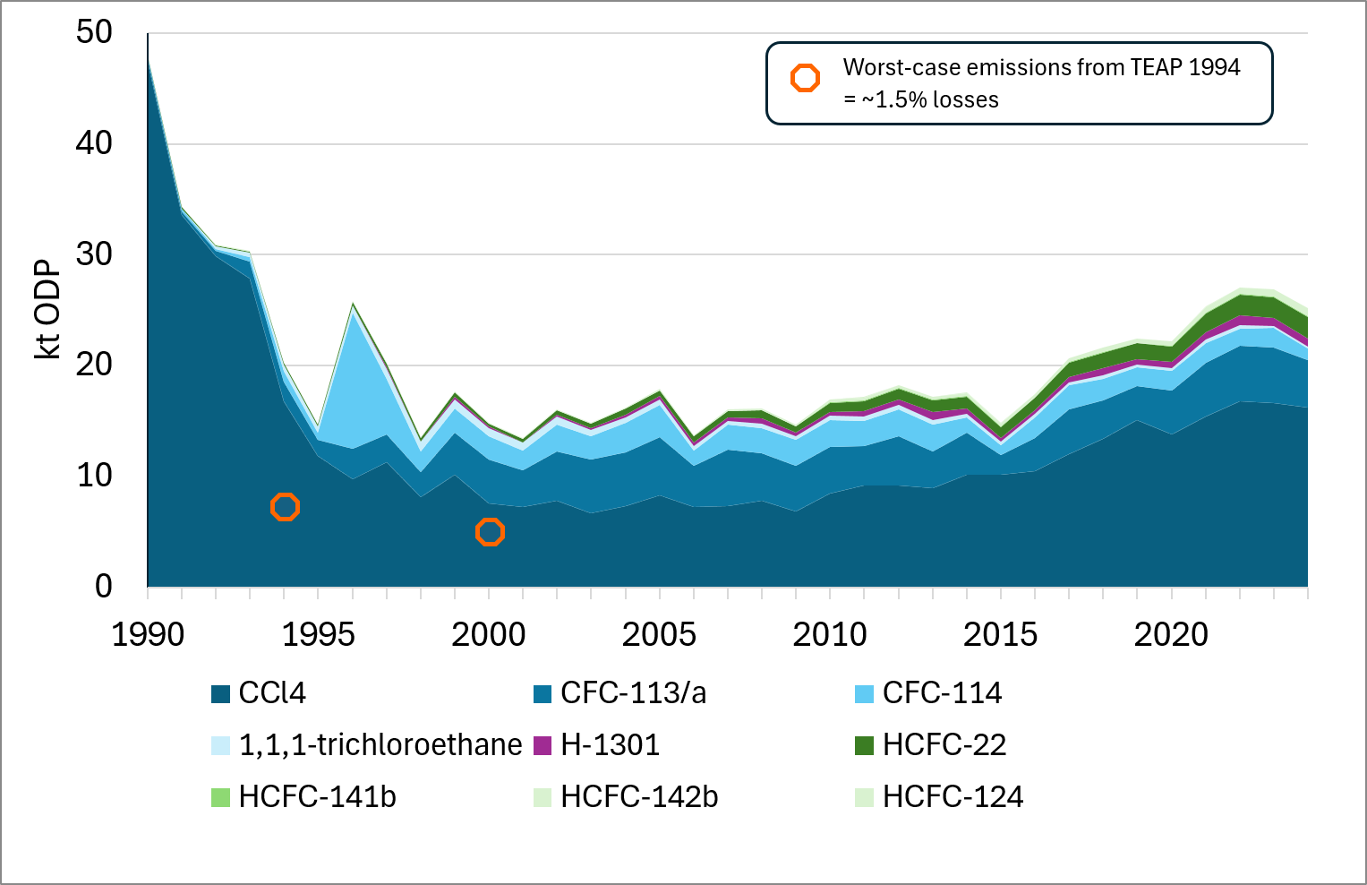
Feedstock emissions with TEAP-revised loss ratios assuming identical ratios in the past
ODP-kt yr⁻¹
Notes:
If 3.6 resp 4.3% are taken as emissions. Emissions are not potentially not "insignificant" anymore

Slide 15
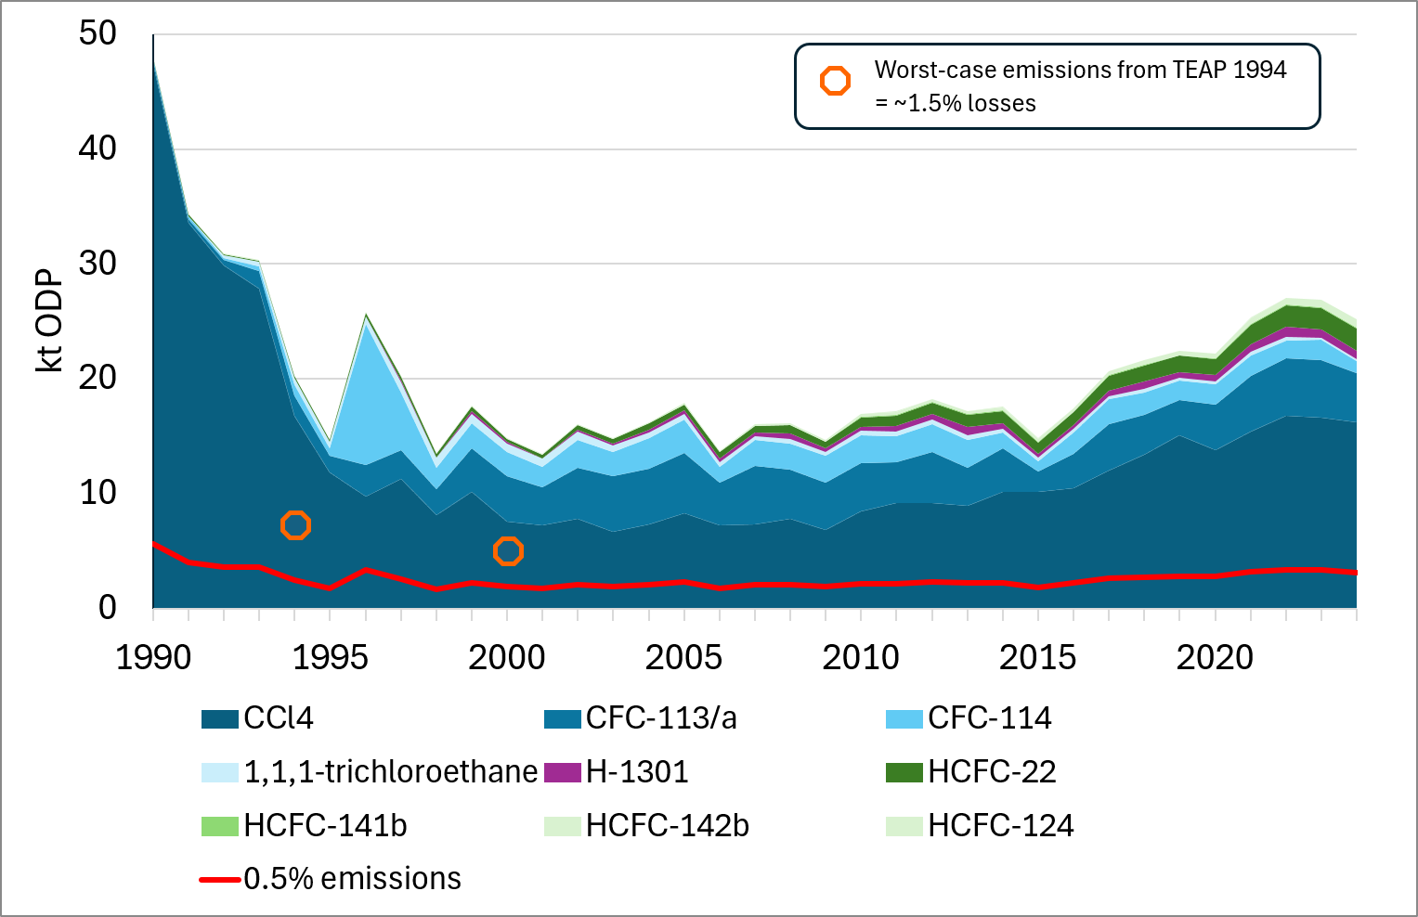
Feedstock emissions with TEAP-revised loss ratios assuming identical ratios in the past
ODP-kt yr⁻¹
Notes:
And relative to 0.5% a gap occurs

Slide 16
Impact of Elevated Feedstock Emissions on Future Stratospheric Ozone
Model
Emissions of 3.6% (4.3% CCl₄) vs. 0.5% from feedstock production/use
Default: 4% production increase for the next 10 years (2025-2034)
Specific polymer feedstocks: 4% production increase until 2050
Stable production between 2050 and 2100
Outcome
Emissions
Atmospheric concentrations ➔ EESC
Notes:
The consequences of this gap was discussed in the Nature Comm paper in terms of emissions and in terms of ist influence on EESC (equivalent effective stratospheric chlorine)

Slide 17
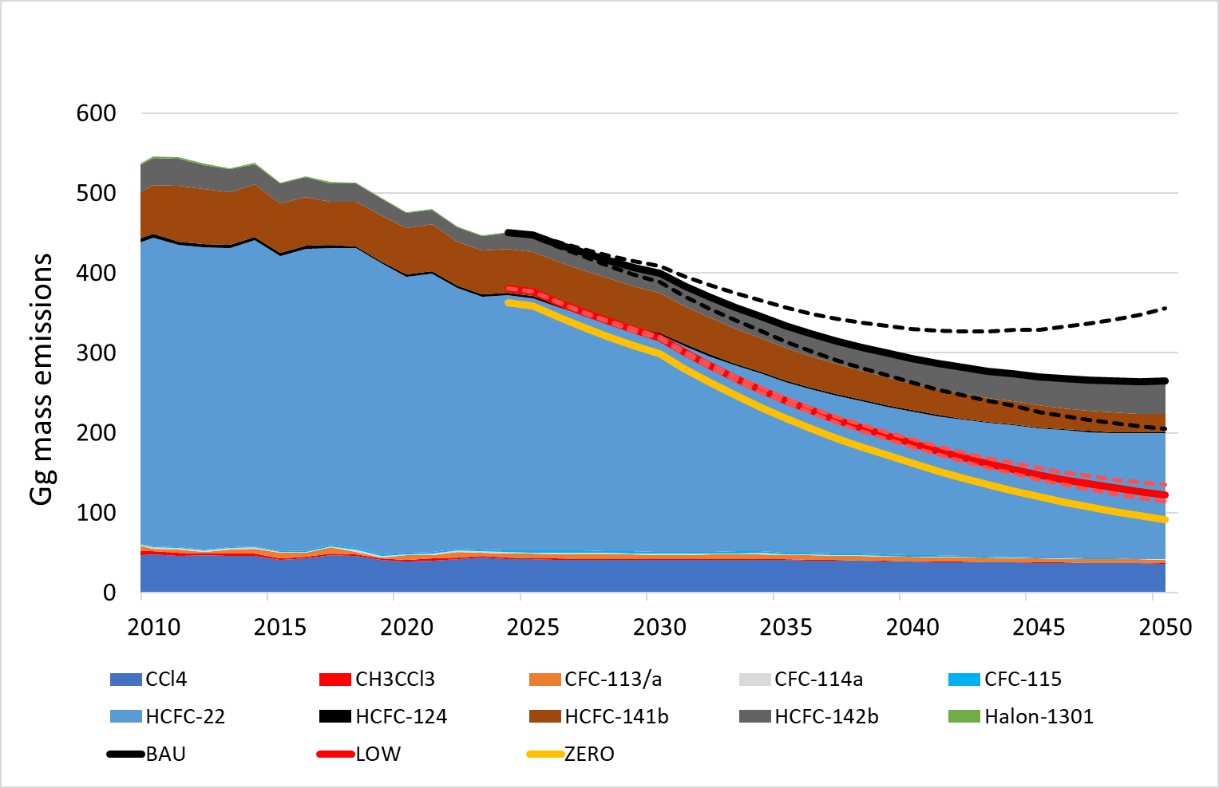
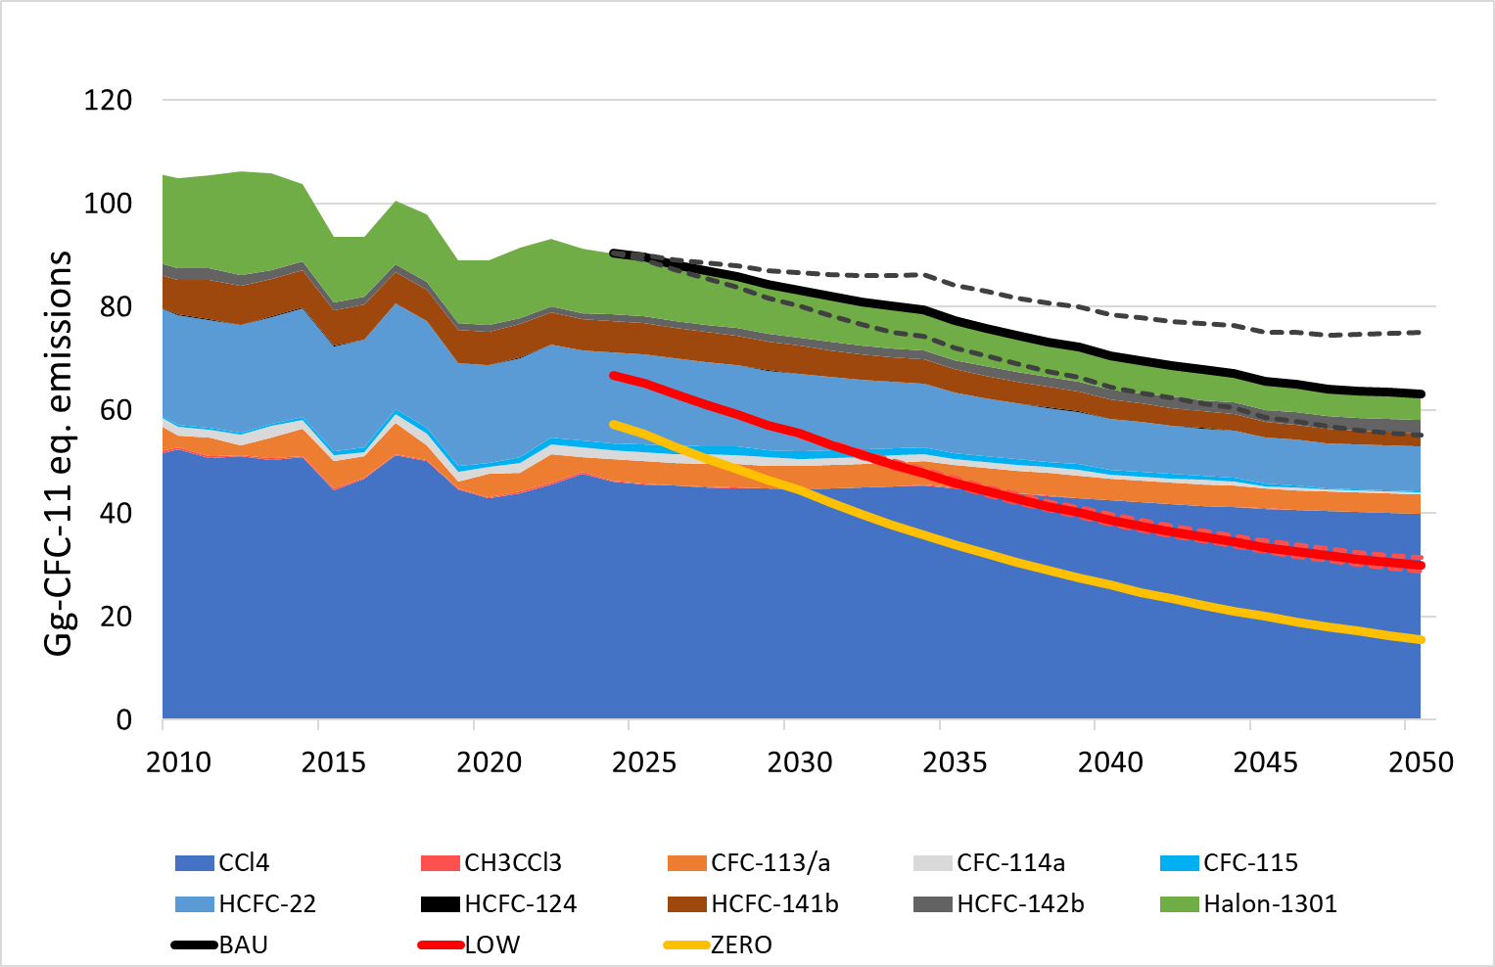
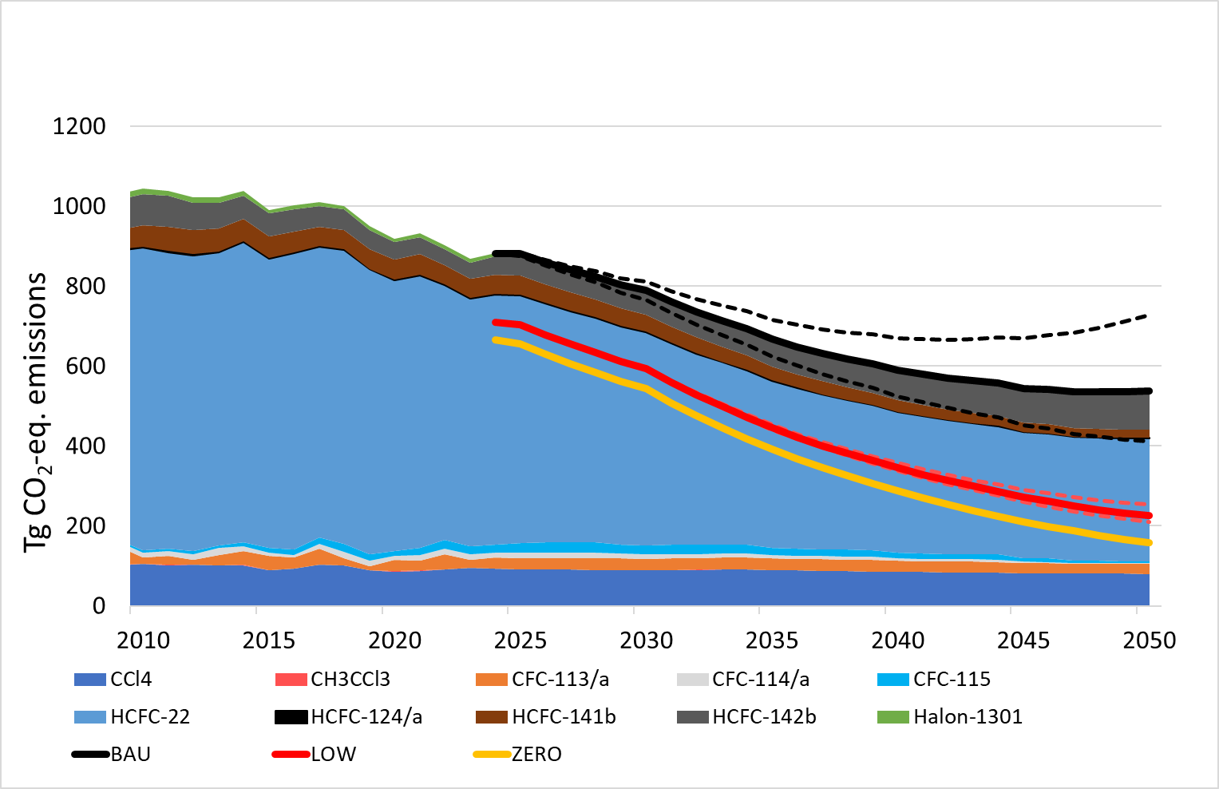

Projections of emissions until 2050
Mass Gg yr⁻¹
Ozone-relevant CFC-11 eq.
Climate relevant CO₂-eq.
~300 Tg CO₂-eq.
Spain
Notes:
For mass emissions, ODP kt emissions and CO2 eq. Emissions, values do no longer decrease in around 2050. The decrease until then is lead by emissions from banks, such as air conditioners (HCFC-22) and refrigeration.

Slide 18
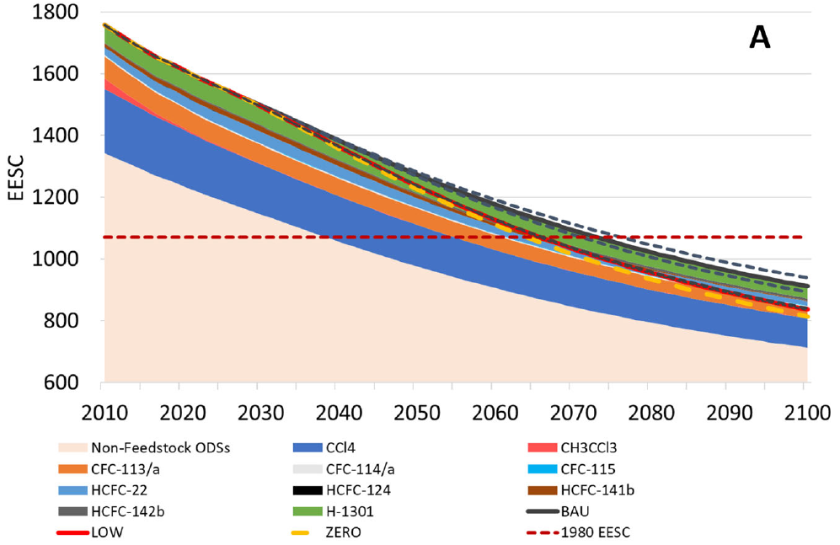
Delay of Mid-Latitude Ozone Layer Recovery by 7 (6 – 11) years
Equivalent effective stratospheric chlorine (EESC) in 1980 (pre-ODS)
0.5%
scenario
Business
as usual
Notes:
EESC for related to non-feedstock related emissions (from banks) in beige (or sand color) and on top the influence of emissions from feedtsocks.
The ozone layer in the mid-latitude would recover 7 (6-11) years later than foreseen. The 0.5% and the yellow zero line are practically identical. Therefore with 0.5% emissions, no significant effect on the recovery of the ozone layer is expected.

Slide 19
Summary
Feedstock use of ODSs is currently increasing for the production of HFOs and halogenated polymers.
If current feedstock emissions of around 4% are not contained, the delay in ozone recovery will be 7 (6-11) years.
The influence is highest for CCl₄, HCFC-22, CFC-113/a and HCFC-142b.
With 0.5% feedstock-related emissions, there would be practically no delay.

Slide 20
Usage of ODSs as feedstocks
gases
foaming
cooling
medical
fire
…
polymers
construction
packaging
…
Notes:
Additional slide to show everything again

Slide 21
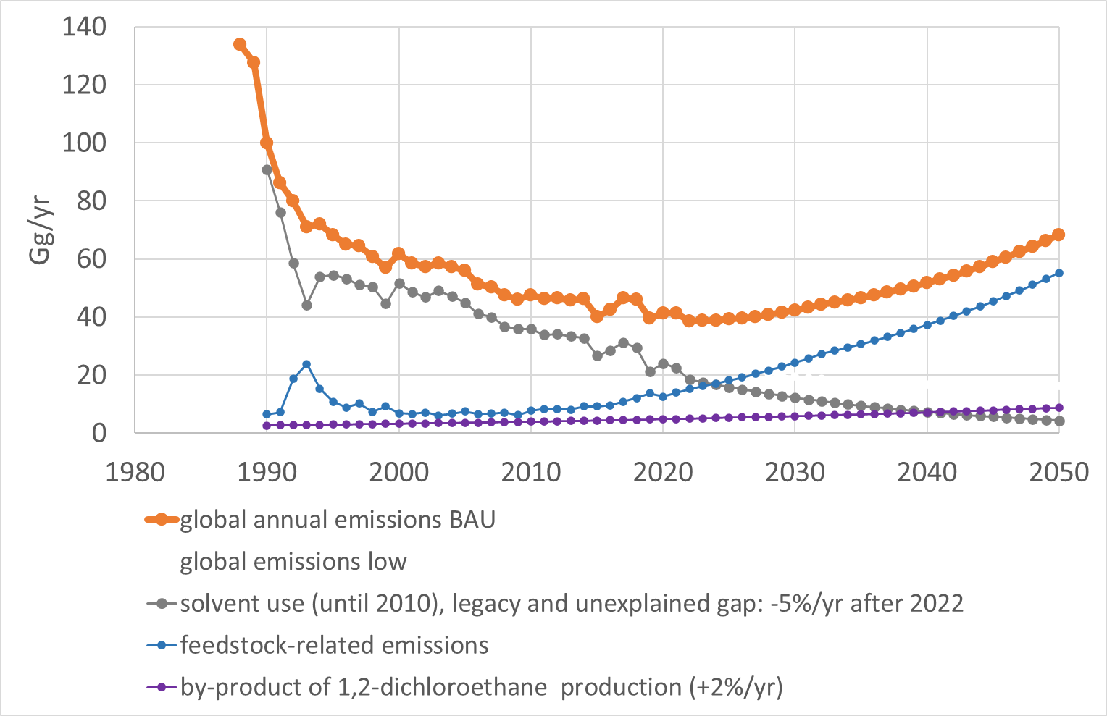
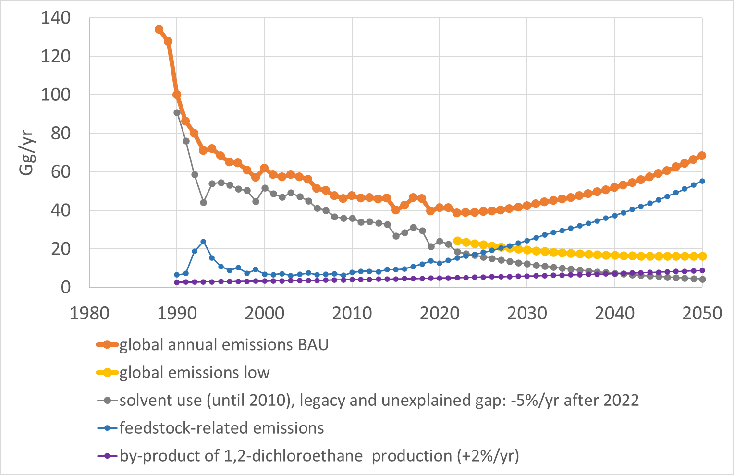
CCl₄ projections: business-as-usual (BAU) and low emissions case
Notes:
Additional slide for CCl4

Slide 22
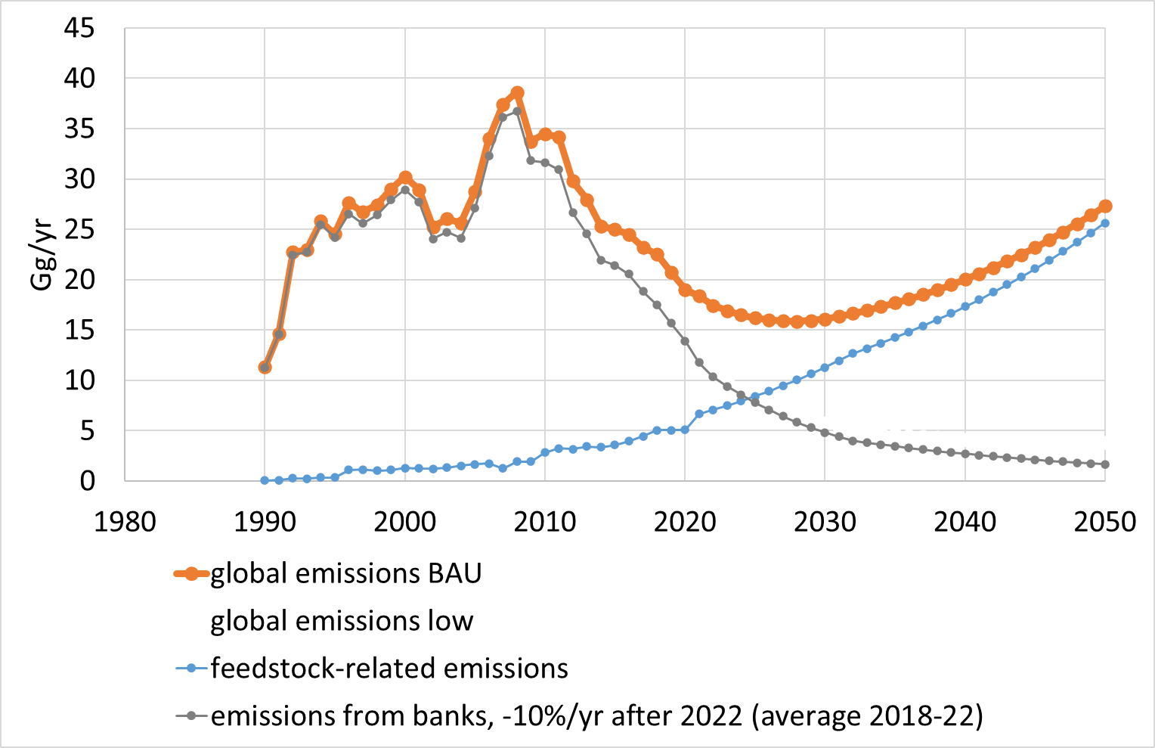
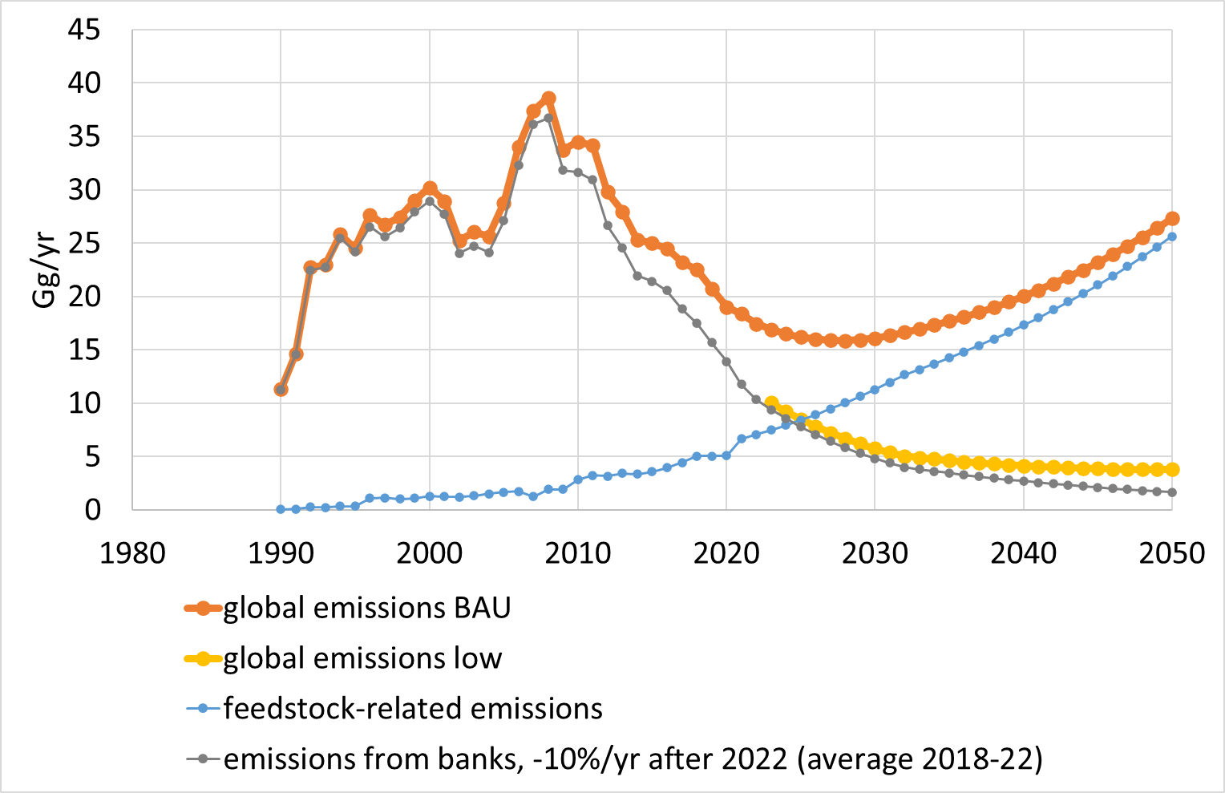
HCFC-142b projections: business-as-usual (BAU) and low emissions case
Notes:
HCFC-142 for PVDF

